Slide 2
MANAGING COMMUNICABLE DISEASES IN UTTAR PRADESH
Sanchari Rog Niyantran Abhiyan and Unified Disease Surveillance Portal (UDSP)
DR VIKASENDU AGARWAL State Surveillance Officer
Uttar Pradesh
1

Slide 3
Introduction to Communicable diseases
Mosquito borne diseases (Dengue, Malaria, Chikungunya and JE) : Prevention, Clinical manifestations and management
Water borne diseases (Acute diarrhoeal diseases, Viral Hepatitis A and E and Cholera) : Prevention, Clinical manifestations and clinical management
Public support in Disease mitigation
Home based care of common disease conditions
Role of Private sector in disease prevention, outbreak alert generation and response
Digital interventions in disease reporting (Unified Disease surveillance Portal-UDSP)
Sanchari Rog Niyantran Abhiyan
AGENDA
2

Slide 4
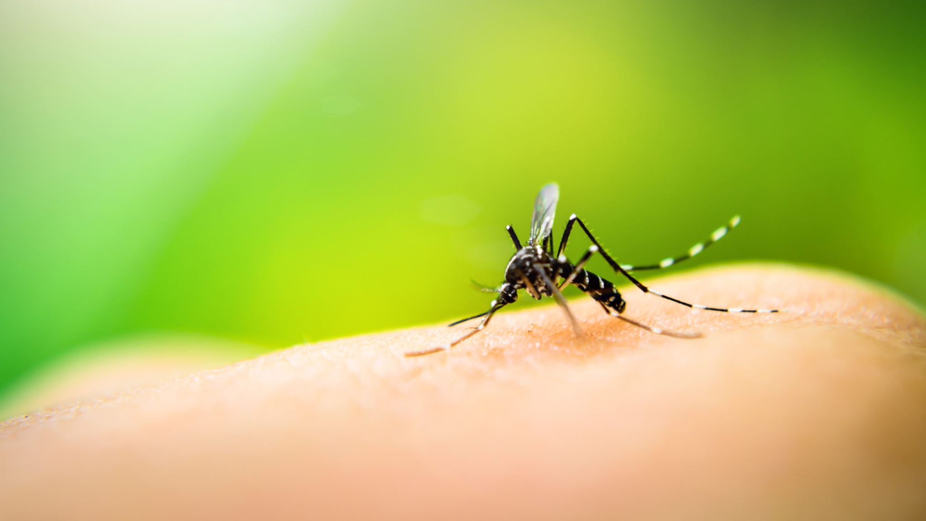
Introduction to Communicable diseases
3

Slide 5
What are Communicable diseases
Communicable diseases are illnesses that spread from one person to another or from an animal to a person.
Modes of transmission for communicable diseases :
Respiratory droplet spread from a sick person sneezing or coughing
Bites from insects or animals that can transmit the disease
Ingestion of contaminated food or water
Direct contact with a sick person
Contact with blood or other body fluids
Breathing in viruses or bacteria in the air
Contact with a contaminated surface or object
4

Slide 6
Important Communicable Diseases in Uttar Pradesh
Droplet Infections
Acute respiratory infections due to viruses (Common cold)
Tuberculosis
Leprosy
Measles
Mumps
Diphtheria
Pertusis
Water Borne
Typhoid (Enteric fever)
Viral Hepatitis A and E
Acute diarrhoeal diseases (Enteroviral diarrhoea)
Cholera
Vector Borne
Mosquito Borne
Malaria
Dengue
Chikungunya
Japanese Encephalitis
Filaria
Fly Borne
Kala Azar
Other animals (Rodents/ Cattle)
Scrub Typhus
Leptospirosis
5

Slide 7
Why are communicable diseases important in Uttar Pradesh
High Population Density
Can facilitate the rapid spread of communicable diseases
Socioeconomic Factors
Poverty and lacking access to adequate healthcare, sanitation, and clean water increase the risk of communicable diseases as people may not have the means to protect themselves or seek timely medical treatment.
Urbanization and Migration
Rapid urbanization and consequent rise of Urban slums which often lack proper sanitation and healthcare infrastructure, create ideal conditions for the spread of communicable diseases.
Globalization and Travel
With Uttar Pradesh positioning itself and emerging as a major tourist hub in recent times, possibility of spread of imported communicable diseases can not be ignored.
Impact on Healthcare System and Economy
The burden of communicable diseases can overwhelm healthcare systems and strain resources, leading to increased healthcare costs and economic losses due to decreased productivity and absenteeism.
6

Slide 8
Addressing communicable diseases in Uttar Pradesh
Requires a comprehensive approach that includes
Strong political will
Sustained and coordinated interdepartmental activities
Improving healthcare infrastructure
Implementing effective disease surveillance and control measures
Addressing underlying socioeconomic determinants of health.
Promoting public health education and awareness
7

Slide 9
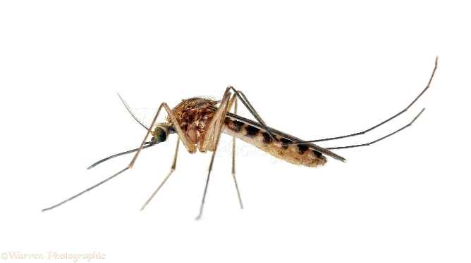
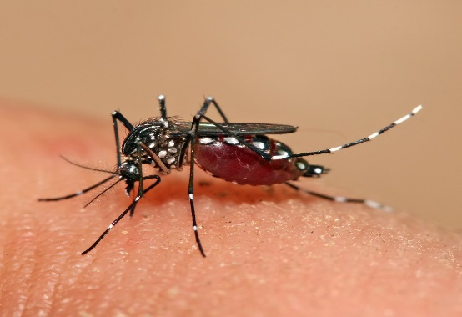
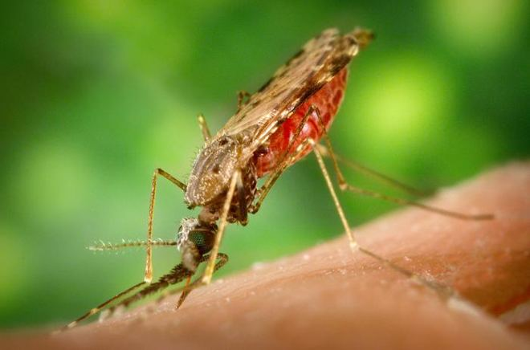
Mosquito borne diseases (Dengue, Malaria, Chikungunya and JE)
Prevention, Clinical manifestations and management
8

Slide 10
Common Mosquitoes causing Diseases
Aedes : Dengue, Chikungunya, Zika
Aedes aegypti :
A domestic mosquito species, thrives in urban areas and breeds in stagnant water sources commonly found in and around human habitation
active during the day, with peak biting periods in the early morning and late afternoon.
Aedes albopictus :
Also known as the Asian tiger mosquito, more commonly found in rural and suburban areas.
Anopheles : Malaria
Anopheles stephensi and Anopheles culicifacies are the most significant vectors of malaria
Culex : Japanese Encephalitis (JE), lymphatic filariasis, West Nile Virus
Culex quinquefasciatus :
Commonly found in urban and rural areas throughout India
Known to transmit the filarial parasites
9

Slide 11
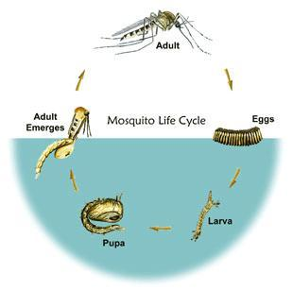
Life Cycle of a Mosquito
4 stages in the life cycle
Eggs- must be laid in water in order to hatch.
Larvae- are aquatic (live in water).
Pupae- are aquatic (live in water).
Adults- Free flying insects.
Aquatic
Stages
The first three stages are aquatic and last 7-14 days, depending on the species and the ambient temperature.
10

Slide 12
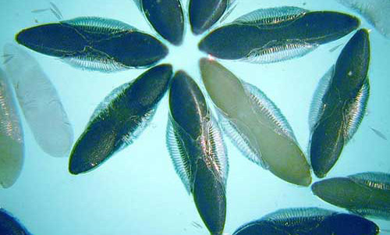
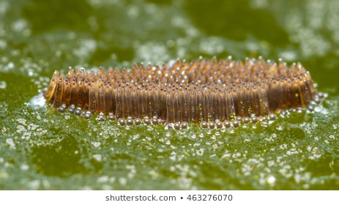
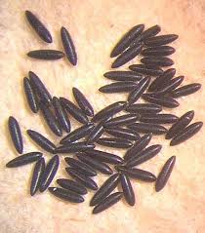
Mosquito Eggs
Anopheles
Single eggs with floats
Laid on Water
Culex
Egg Rafts
Aedes
Single eggs without floats
Laid on Sides of containers
11

Slide 13
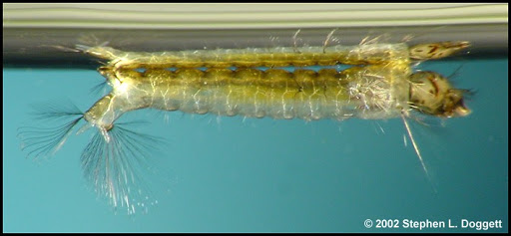
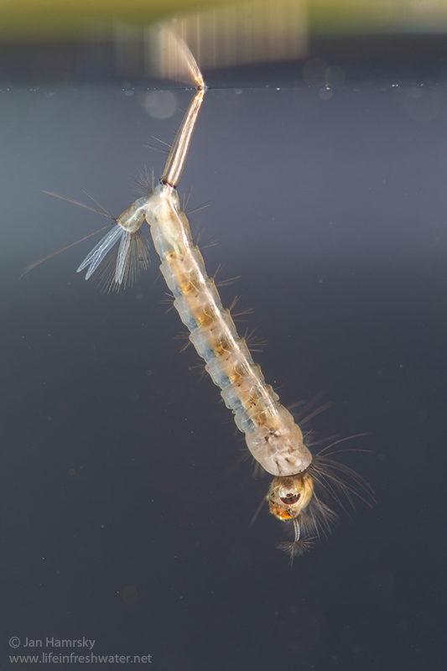
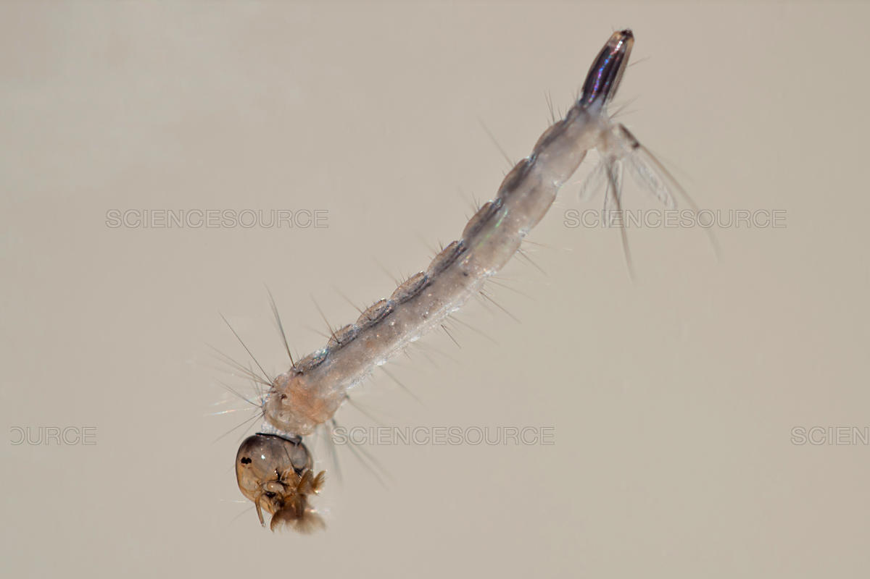
Mosquito Larvae (Wigglers)
Anopheles
No Siphon
Culex
Long siphon
Aedes
Short Siphon
12

Slide 14
Mosquito Pupae (Tumblers)
Pupal stage is mobile
Unlike most insects
Transform from aquatic larva to terrestrial adult
Called “tumblers”
Breath through respiratory “trumpets”
Do not feed
Pupation takes 2-3 days
13

Slide 15
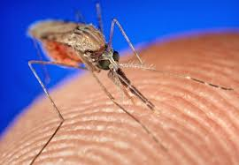
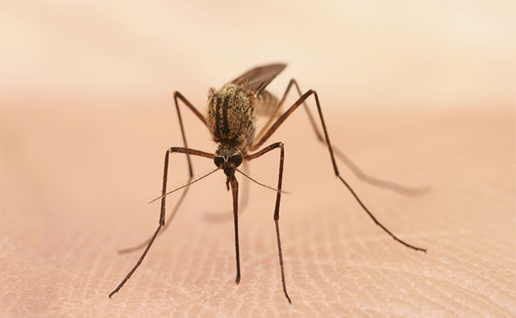
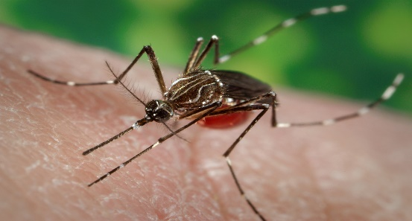
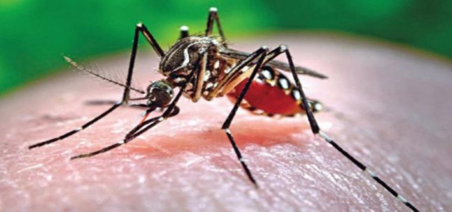
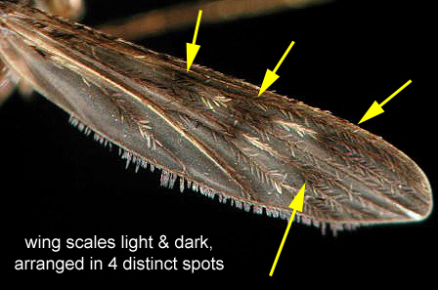
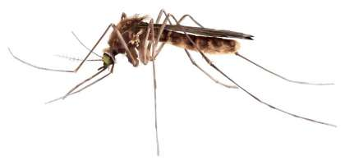
Adult Mosquitoes
Anopheles
Culex
Aedes
Rest 45 degree angle to surface
Rest Horizontal to surface
Rest Horizontal to surface
Palps short
Palps as long as proboscis
Palps short
Wings not spotted
Pointed tip to abdomen
Blunt tip to abdomen
14

Slide 16
DENGUE PREVENTION, CONTROL AND CLINICAL MANAGEMENT
15

Slide 17
Dengue
Dengue is an acute febrile viral infection.
It is caused by any one of four closely related dengue viruses.
The viruses are transmitted to humans by the bite of an infected female Aedes aegypti mosquito.
Dengue is the most rapidly spreading mosquito-borne viral disease, with a 30-fold increase in global incidence over the past 50 years.
16

Slide 18
Factors Contributing to Spread of Dengue
Demographic and Social changes:-
Unplanned and uncontrolled urbanization
put severe constraints on civic amenities like water supply and solid waste
disposal
thereby increasing the breeding potential of the vector species
Water supply
Solid waste management
Lack of Mosquito control infrastructure
Introduction of non-biodegradable plastic products, paper cups, used tyres etc.
17

Slide 19
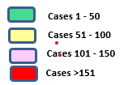
Geographical Expansion of Dengue Positive Cases
2021
2022
18

Slide 20
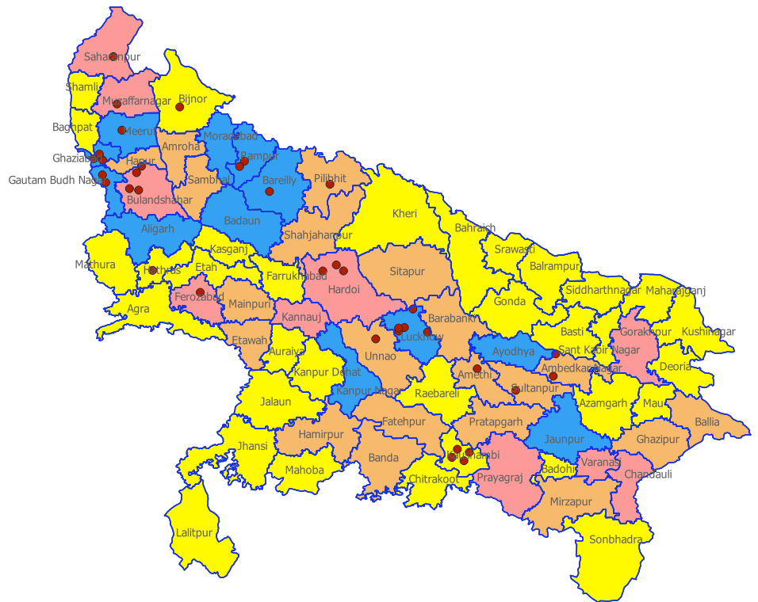
Cases & Deaths – Dengue, 2023
No cases
1 – 250 cases
250 – 500 cases
500 – 750 cases
# Cases : 35,402
# Deaths : 36
>750 cases
1 dot = 1 death case
S.No. | District | No.ōf Deaths
1 | Amethi | 1
2 | Bareilly | 1
3 | Bijnor | 1
4 | Firozabad | 1
5 | Hathras | 1
6 | Meerut | 1
7 | Muzaffarnagar | 1
8 | Pilibhit | 1
9 | Saharanpur | 1
10 | Sultanpur | 1
11 | Unnao | 1
12 | Ambedkar Nagar | 2
13 | Gautam Buddha Nagar | 2
14 | Rampur | 2
15 | Ghaziabad | 3
16 | Hardoi | 3
17 | Bulandshahar | 4
18 | Kaushambi | 4
19 | Lucknow | 5
*note : dots have been placed randomly within district boundary, map not to scale
19

Slide 21
Month-wise no. of Cases & Deaths – Dengue, 2023
20

Slide 22
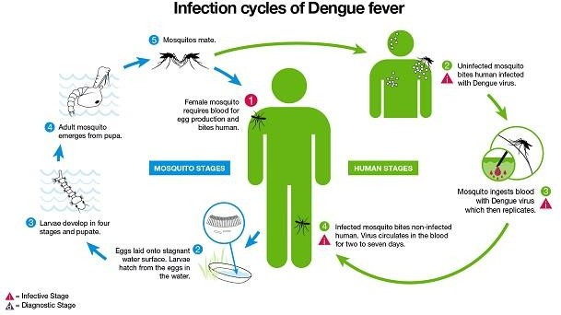
21

Slide 23
Laboratory Diagnosis
GoI recommends use of
ELISA based antigen detection test (NS1) for diagnosing the cases from 1st
day onwards and
antibody detection test IgM Capture ELISA (MAC ELISA) for diagnosing the cases after 5th day of onset of disease for confirmation of Dengue infection.
ELISA :- Enzyme-linked Immunosorbent Assay
22

Slide 24
NS1 Antigen test (RDT)
Very low sensitivity and specificity
High % of both false positive and false negative outcomes
Results are not dependable and are therefore RDT not advised to be used for diagnosis
Nevertheless
The test is available freely in the market
A lot of Private sector Hospitals and labs use this test
Private sector should not be discouraged from reporting NS1 Antigen positive cases
The test result should be taken as an indicative result and case based activities must be conducted if there are NS1 antigen positive reports from the field (either from Private and Public sector labs)
Confirmation of diagnosis by ELISA should be done before declaring the case as Dengue positive and including him/her in the Dengue line list
Cases with Clinical symptoms or laboratory findings suggestive of Dengue should be carefully evaluated and CAN NOT BE LABELLED AS DENGUE NEGATIVE based on Negative NS1 antigen test only.
23

Slide 25
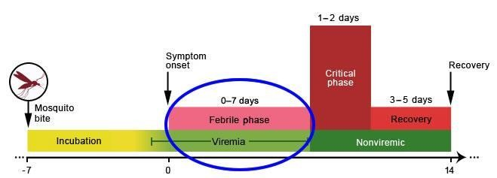
Clinical Course of Dengue
Characteristics of the febrile phase
Typical duration of 0–7 days, Biphasic fever possible
Defervescence occurs between day 3 and day 8 of the illness.
Monitoring during defervescence and for warning signs crucial to identifying progression into the critical phase.
Incubation period of 4-7 days
Sudden onset of flu-like symptoms including fever, chills, headache, nausea, vomiting, severe joint pain (arthralgia) and rash.
24

Slide 26
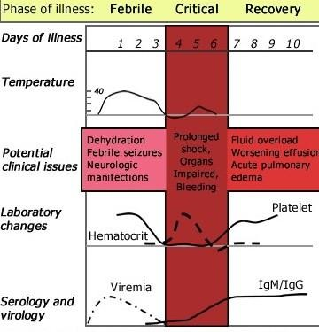
Summary diagram for Phases of Illness
25

Slide 27
Prevention and control of Dengue
Prevention is the key and options for preventing and controlling Dengue are:
a) To control larval habitats in and around:-
people’s homes,
workplaces,
unclaimed empty spaces,
dump sites and public areas such as place of worships/recreational centers,
roadsides, playgrounds, and cemeteries
b) To reduce human–vector contact
c) To ensure prompt diagnosis of cases of fever and appropriate clinical management
No specific antiviral treatment or vaccine against dengue is available.
26

Slide 28
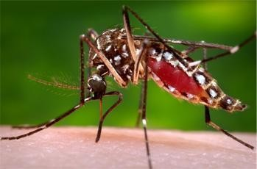
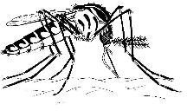
Dengue Mosquito Facts
General information
Aedes aegypti is a small, dark mosquito with white lyre shaped markings and banded legs.
They prefer to bite indoors primarily during the day.
These mosquitoes mostly use artificial containers with water to lay their eggs.
Eggs are resistant to desiccation and can survive for periods of six or more months. When rain floods the eggs with water, the larvae hatch.
Egg production sites are within or in close proximity to households.
The real mosquito size is approximately ¼”
27

Slide 29
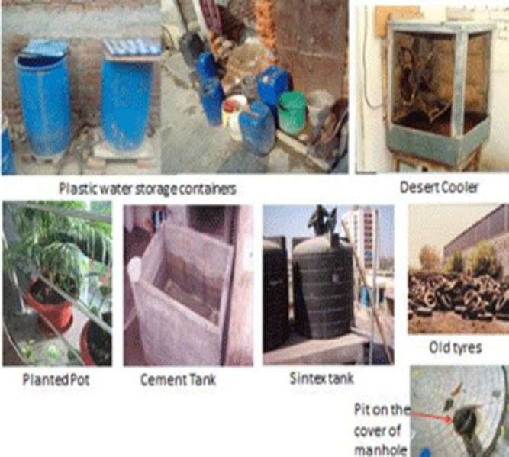
What are the common breeding sites of Aedes mosquitoes?
28

Slide 30
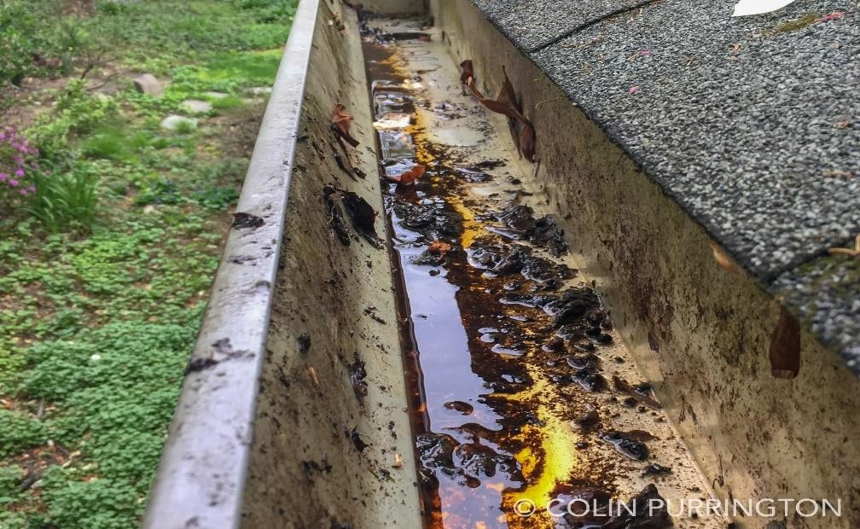
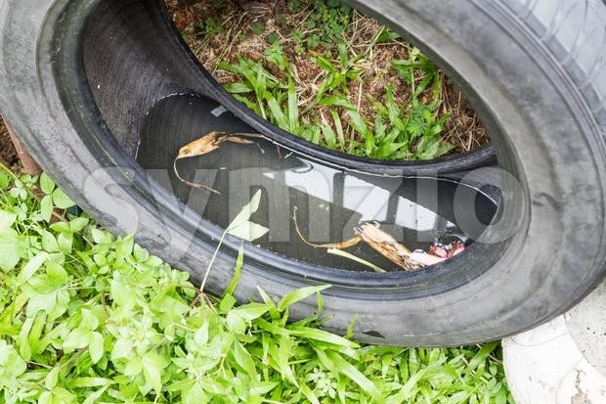
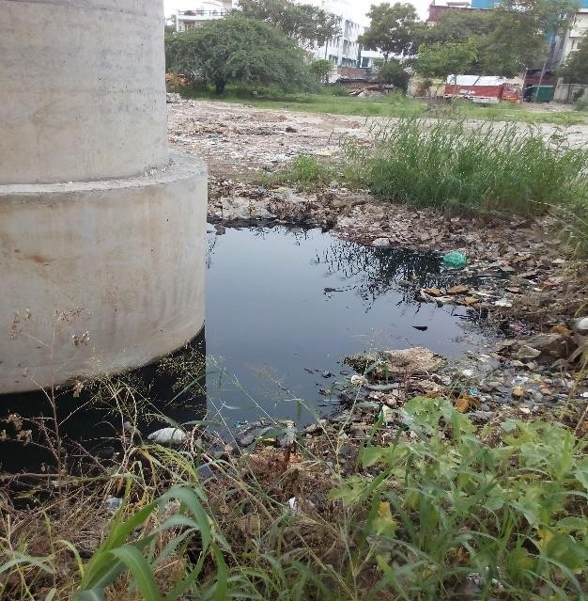
Water Needed For Mosquito Development
Female mosquitoes lay eggs in suitable conditions for larval survival
On or near water
Stationary or very slow moving water
Suitable food source for larvae
Microbial growth or organic matter
Protected from wind and waves
29

Slide 31
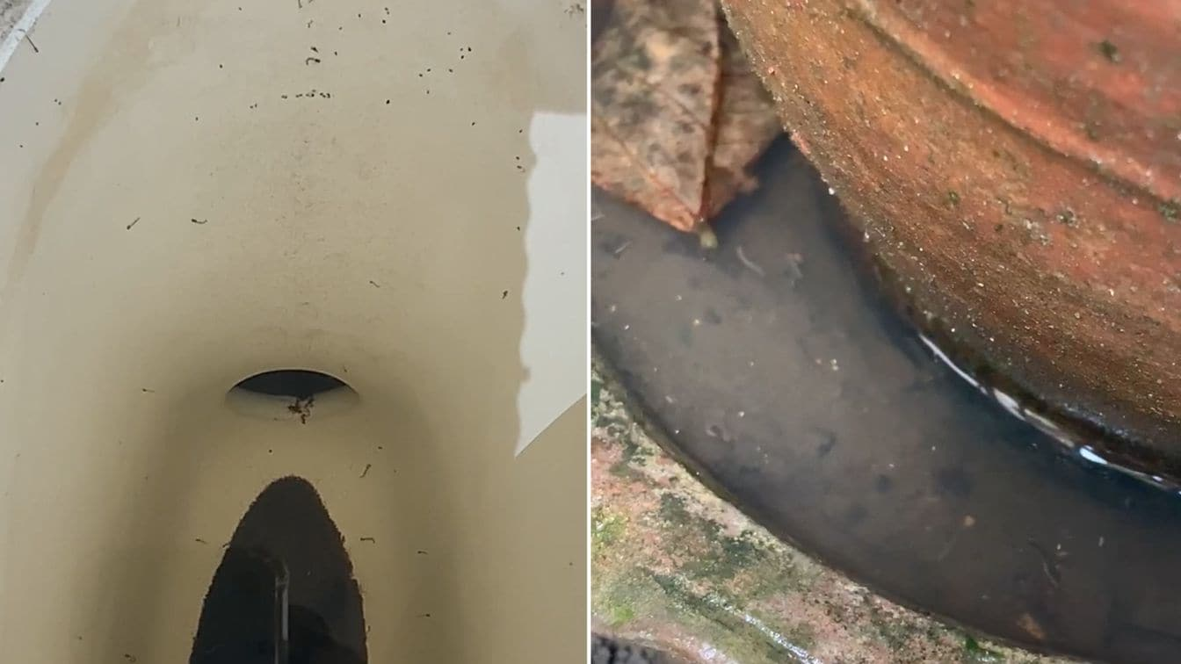
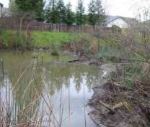
Where to look for Aedes Mosquitoes
Small bodies of water
Need ≈1 tsp of water to develop
Any water that does not dry up in ≈1 week
Places where eggs are laid
Sides of containers with firm surfaces
Do NOT lay eggs in ground pools, swamps or pond edged with soft soil sides
Containers in more shaded than in sunny locations
Firm sides
Soft soil edges
30

Slide 32
LARVAL SURVEY
COMPUTATION OF RESULTS
HOUSE/ PREMISE INDEX (HI%)
_{HI =} 𝐍𝐨.𝐨𝐟 𝐡𝐨𝐮𝐬𝐞𝐬 + 𝐟𝐨𝐫 𝐀𝐞𝐝𝐞𝐬 𝐋𝐚𝐫𝐯𝐚𝐞 𝐗 𝟏𝟎𝟎 %
𝐧𝐨.𝐨𝐟 𝐡𝐨𝐮𝐬𝐞𝐬 𝐢𝐧𝐬𝐩𝐞𝐜𝐭𝐞𝐝
CONTAINER INDEX (CI%)
_{CI =} 𝐍𝐨.𝐨𝐟 𝐜𝐨𝐧𝐭𝐚𝐢𝐧𝐞𝐫𝐬 + 𝐟𝐨𝐫 𝐀𝐞𝐝𝐞𝐬 𝐋𝐚𝐫𝐯𝐚𝐞 𝐗 𝟏𝟎𝟎 %
𝐧𝐨.𝐨𝐟 𝐜𝐨𝐧𝐭𝐚𝐢𝐧𝐞𝐫𝐬 𝐢𝐧𝐬𝐩𝐞𝐜𝐭𝐞𝐝
A. BRETEAU INDEX (BI)
_{BI =} 𝐍𝐨.𝐨𝐟 𝐜𝐨𝐧𝐭𝐚𝐢𝐧𝐞𝐫𝐬 + 𝐟𝐨𝐫 𝐀𝐞𝐝𝐞𝐬 𝐋𝐚𝐫𝐯𝐚𝐞
𝟏𝟎𝟎 𝐡𝐨𝐮𝐬𝐞𝐬 𝐢𝐧𝐬𝐩𝐞𝐜𝐭𝐞𝐝
31

Slide 33
Source reduction (reducing sources of larval habitats)
Covering domestic water-storage containers
Cleaning/scrubbing of domestic water-storage containers
Temephos (1PPM) needs to be applied on a weekly basis in case water containers cannot be emptied.
Big water drums and small earthen jars need to be turned upside down once a week.
Filtering water from one container to another through cloth can help to trap and dislodge larvae and pupae.
Cleaning of water coolers, ACs, refrigerators
Wherever possible these potential breeding spots need to be dried up once in a week.
32

Slide 34
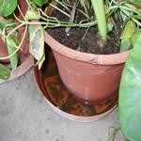
Source reduction (reducing sources of larval habitats)
Mosquito-proofing of overhead tanks or underground reservoirs
Mosquito-proofing of overhead tanks or underground reservoirs
Managing discarded receptacles
Disposal and recycling of used/old tyres
Cleaning flowerpots/vases and ant-traps and changing water of pet bowls and bird baths
Observation of dry day
Every week dry day should be observed by the community for source reduction.
33

Slide 35
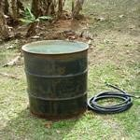
Control Mosquitoes that Spread Dengue and Chikungunya Viruses
Keep mosquitoes out of your home:
Use screens on windows and doors.
Repair holes in screens.
Use air conditioning when available.
Prevent mosquito bites:
Wear long sleeve shirts, long pants, socks and shoes when mosquitoes are most active
Use insect repellent such as DEET, picaridin, oil of lemon
eucalyptus or IR3535 only to exposed skin and/or clothing.
Do not use repellents under clothing.
DOs
Put plants in soil, not in water.
Drain water from pools when not in use.
Recycle used tires or keep them protected from rain.
Drain & dump any standing water.
Weekly, scrub vases & containers to remove mosquito eggs.
34

Slide 36
Management of Dengue
Epidemic Management
Space mobilization for Dengue Corner in Hospital
Staff mobilization
Augmentation of Lab. Services
Diagnosis not required in all cases during Epidemic
Augmentation of blood bank services
increase of blood and blood component
Case management
Individual case management
Diagnosis
Severity assessment
Specific management
35

Slide 37
Clinical Management of Dengue
Diagnosis of Dengue
Case Definition:
Probable Dengue:
A case compatible with clinical criteria of DF during outbreak. (clinical criteria of Dengue: Acute febrile illness of 2-7 days duration with two or more of the following : Headache, retro-orbital pain, mayalgia, athralgia, rash, haemorrhagic manicestation)
Or RDT +ve for NS1 , IgM
Confirmed Dengue:
ELISA +ve for IgM, NS1
Culture, PCR,
DF, DHF, DSS / Asymptomatic, Mild, Moderate, Severe
1. Diagnosis of Dengue
Clinical diagnosis
Laboratory diagnosis
National policy
2. Clinical presentation
Pathogenesis of Clinical presentation
3. . Treatment
Symptomatic management
Specific management
Critical care management
4. Outbreak Management
Dengue Corner
36

Slide 38
Laboratory Tests
Clinical laboratory tests
CBC--WBC, platelets, hematocrit
Albumin
Liver function tests
Urine-check for microscopic hematuria
Dengue-specific tests
Virus isolation
Serology
Antigen : NS1
Antibody: IgM, IgG
37

Slide 39
Diagnostic approach to suspected dengue cases
ACUTE FEBRILE ILLNESS (AFI)
High-grade febrile illness (>39°C), facial flushing, skin erythema, retro-orbital pain, myalgia, arthralgia, nausea and vomiting, and with or without hemorrhagic manifestations*.
Clinical suspicion based on signs and symptoms
Suspected dengue
Chikungunya
Malaria
Scrub Typhus
Influenza (H1N1)
Leptospirosis
Typhoid fever
Laboratory test for COVID 19 (RT-PCR, CBNAAT, or RAT)**
COVID-19 +VE
Shift to COVID ward/isolation
COVID-19 –VE
Shift to IPD/OPD Management
Laboratory Confirmation for Dengue
Duration of illness/ (Fever)
Duration ≤ 5 days
Duration ≥ 5 days
Virus isolation
Dengue RT-PCR
Dengue NS1 antigen detection by ELISA
NS1 Antigen by RDT
Positive
Dengue IgM by MAC-ELISA#
IgG seroconversion in paired sera or fourfold rise IgG titre
Negative
Repeat Dengue IgM after 48 hours
Negative
* Haemorrhagic manifestations include petechiae, purpura, gum or nasal bleeding, gastrointestinal bleeding, haematuria, menorrhagia and positive tourniquet test.
** Depending on the availability of the test, RT-PCR ;Real –time reverse transcriptase-polymerase chain reaction; CBNAAT; Cartridge-based nucleic acid amplification test ; RAT ; Rapid antigen test)
# IgM capture enzyme-linked immunosorbent assay (MAC-ELISA)
38
Notes:
Flow chart 2. Diagnostic approach to suspected dengue cases

Slide 40
Clinical features and laboratory investigations in dengue infection
Dengue virus infection
Clinical manifestations
Symptoms
Signs
Laboratory findings
Clinical symptoms
Fever
Rush
Headache
Retro orbital or Ocular pain
Myalgia
bone pain
Arthralgia
Warnings symptoms
Abdominal pain
Lethargy
Dyspnea
Altered sensorium
Hemorrhagic symptoms
Petechiae
Purpura
Ecchymosis
Epistasis
Hypermenorrhea
Hematemesis or melena
Clinical findings
Hepatomegaly
Abdominal tenderness
Pleural effusion
Ascites
Positive tourniquet test
Plasma leakage
Pleural effusion
Ascites
Hypoproteinemia
Hypovolemia
Shock (MAP <65mm HB)
Hemoconcentration
Hematocrit increase of >20%
From baseline Thrombocytopenia Platelet count <1 Lac cells per mm³ Leukopenia
Leukocyte count < 4000 cells per mm³ Coagulopathy
Raised INR or Apt [>1.5Xuin]
Radiological investigation
Chest x-ray/lung Scan Pleural effusion Pulmonary edema Ultrasound Abdomen Acalculous cholecystitis Ascites
39

Slide 41
40

Slide 42
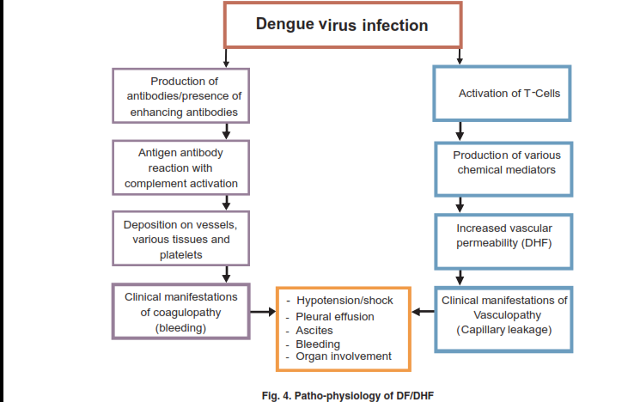
41

Slide 43
Clinical approach and diagnosis of dengue
Acute febrile illness < 7 days
History
Day of fever
Detailed history: fever, retro orbital pain , myalgia ,bleeding , poor oral intake, decrease in urine output
Warning signs and symptoms
Clinical examination
Pulse
BP/postural hypotension
Tachycardia
Pulse pressure (narrow <20 mmHg)
Rash
Mucosal bleeding
Hepatomegaly
Clinical evidence of plural effusion
Ascites
Beside tests & investigations
Tourniquet test
Capillary refilling time (CRT)
Complete blood count(CBC)
HCT
Platelet count
Diagnosis*
1. Mild dengue (Group A)
2. Moderate Dengue (Group B)
3. Severe dengue (Group C)
With significant bleeding
Profound shock
Severe organ involvement
Severe metabolic disorder
Other severe complications
42

Slide 44
Dengue severity classification
Grade I
Fever and nonspecific constitutional symptoms
Positive tourniquet test
Grade 2
Grade 1 manifestations + spontaneous bleeding
Grade 3
Signs of circulatory failure (rapid/weak pulse, narrow pulse pressure, hypotension, cold/clammy skin)
Grade 4
Profound shock (undetectable pulse and BP)
43
Notes:
23

Slide 45
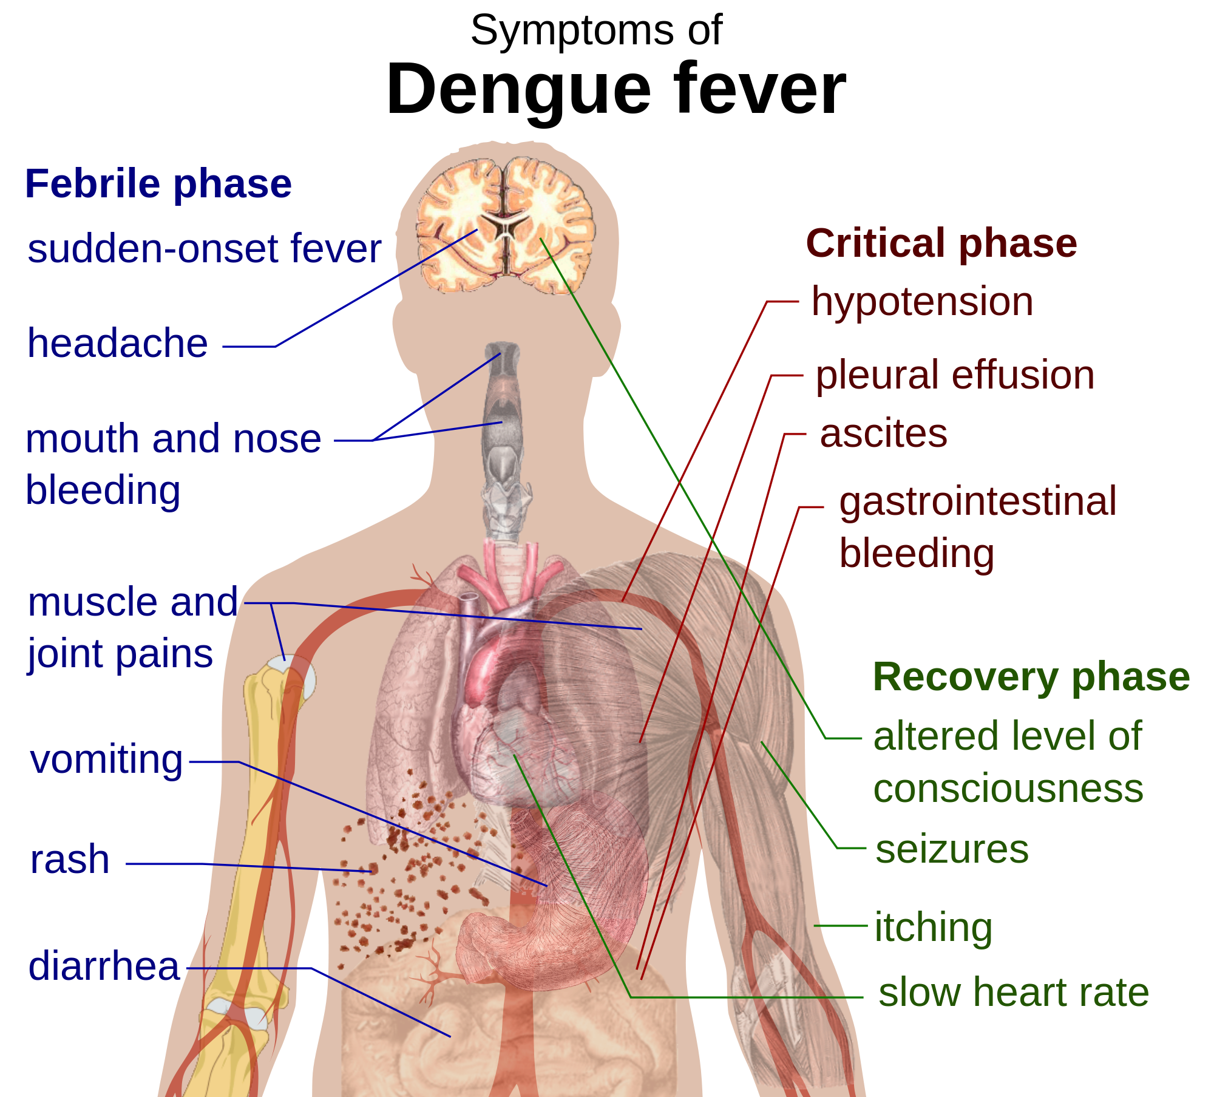
44

Slide 46
Guidelines to be followed in the PHC for management of dengue
Management
of Dengue Fever
HCT high,
Signs of circulatory failure (shock)
Stable, orally accepting HCT normal
Pulse pressure : normal, HCT high
10-15 ml /kg/h crystalloid in 15-30 mins bolus
Advice: Plenty of oral fluid,
PCM SOS and warning signs and symptoms explanation
6ml/kg/h for 1-2 h
Crystalloid ,repeat HCT
No improvement
In VS and HCT
10-20 ml/kg/h crystalloid for 1h; HCT, bleeding++
Home management/ discharge
Improvement
No improvement
Maintenance fluids (IV)
HCT: normal
Persistent hypotension, oliguria, altered sensorium, active bleeding, rapidly falling HCT
Improvement
No improvement
Transfer to higher center
45

Slide 47
Hallmark of DHF
Vascular permeability
Plasma leakage
Intravascular volume
Hypotension
Shock
Pleural effusion
Ascites
Short leakage period (24-48 Hrs)
Rapid recovery phase
Functional changes of vascular endothelium
46

Slide 48
Treatment of Dengue Fever & DHF I & II
Fluids
Rest
Antipyretics (avoid aspirin and non-steroidal anti-inflammatory drugs)
Monitor blood pressure, hematocrit, platelet count, level of consciousness
47

Slide 49
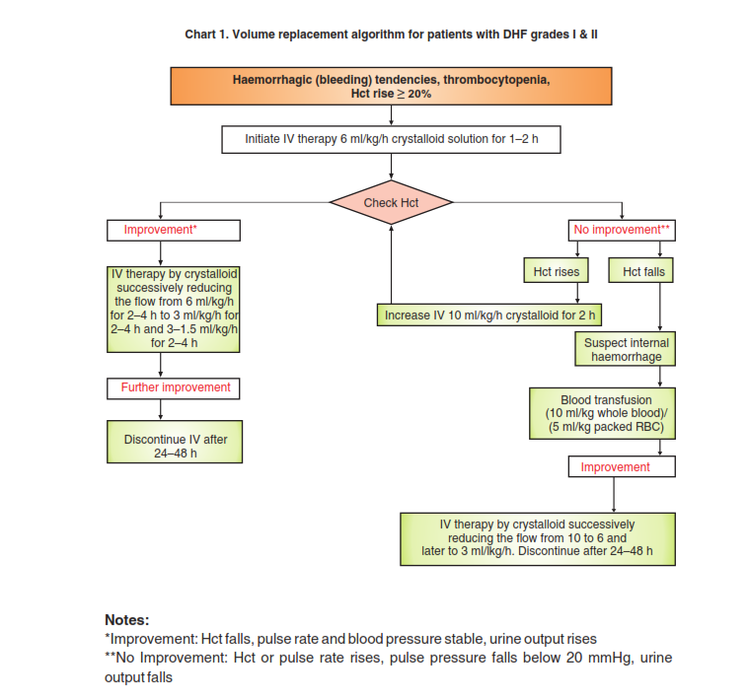
48

Slide 50
Grade B: management of dengue with warning signs in adults
Grade B with warning signs in adults
(systolic pressure maintained + signs of reduced perfusion), HCT high
Start isotonic crystalloid
5-10 mL/kg/h for 1 hour
IMPROVEMENT
BP improved, pulse pressure improved, HCT decreased, urine output improved, capillary refilling
NO
YES
HCT> 45%,
(suspect persistent capillary leakage
HCT <45%,
(suspect severe overt bleed), check Hb
IV crystalloid, reduce gradually
3–5 mL/kg/h for 2–4 hours
2–3 mL/kg/h for 2–4 hours
1.5 mL/kg/h for 2–4 hours
(1st bolus over 15–30 minutes)
Crystalloid or colloid 10 mL/kg/h for 1 h
NO, after 1st bolus
Blood
transfusion/packed
RBC
Colloid 10 mL/kg/h
As clinical improvement is noted,
reduce fluid accordingly
IMPROVEMENT
After 2nd bolus
Stop IV fluids at 24–48 hours
YES
Refractory
hypotension, consider inotropes after 2nd bolus
Detailed investigation to rule out:1. cardiogenic shock; 2. septic shock; 3. metabolic cause; 4. organ dysfunction
Reduce IV crystalloids 7–10 mL/kg/h for 1–2 hours
49
Notes:
Q from national hospital Dr
What happened if patient come with warning signs without sing of reduce perfusion? What is the fluid management in this case?-------------------------edited the flowchart for better understanding
Comment from me:
Start fluid from 5-7 mL/kg/1 h or 5-10 ?------------------it is fine and changed

Slide 51
Grade B: management of dengue with warning signs in children
Grade B with warning signs in children
(systolic pressure maintained + signs of reduced perfusion), HCT high
Start isotonic crystalloid
5-7 mL/kg/h for 1 hour
YES
IMPROVEMENT
BP improved, pulse pressure improved, HCT decreased, urine output improved, capillary refilling
NO
IV crystalloid, reduce gradually
3–5 mL/kg/h for 2–4 hours
2–3 mL/kg/h for 2–4 hours
1.5 mL/kg/h for 2–4 hours
HCT> 45%,
(suspect persistent capillary leakage
HCT <45%,
(suspect severe overt bleed), check Hb
(1st bolus over 15–30 minutes)
Crystalloid or colloid 10 mL/kg/h for 1 h
Blood
transfusion/packed
RBC
Colloid 10 mL/kg/h
As clinical improvement is noted,
reduce fluid accordingly
NO, after 1st bolus
IMPROVEMENT
After 2nd bolus
Stop IV fluids at 24–48 hours
YES
Reduce IV crystalloids 7–10 mL/kg/h for 1–2 hours
Refractory
hypotension, consider inotropes after 2nd bolus
Detailed investigation to rule out:1. cardiogenic shock; 2. septic shock; 3. metabolic cause; 4. organ dysfunction
50
Notes:
Q from national hospital Dr
What happened if patient come with warning signs without sing of reduce perfusion? What is the fluid management in this case?-------------------------edited the flowchart for better understanding
Comment from me:
Start fluid from 5-7 mL/kg/1 h or 5-10 ?------------------it is fine and changed

Slide 52
Treatment of DHF III & IV
All above treatment +
– In case of severe bleeding, give blood rans fusion
– Give platelet rich plasma transfusion exceptionally when platelet counts are below 10,000/ mm3 .
– After blood transfusion, continue fluid therapy at 10 ml/kg/h and reduce it stepwise to bring it down to 3 ml/kg/h and maintain it for 24-48 hrs
51

Slide 53
Grade C: management of dengue with compensated shock in adults
Compensated shock
(systolic pressure maintained + signs of reduced perfusion) pulse pressure <20 mmHg, HCT high
Start isotonic crystalloid
10-15 mL/kg/h for 1 hour
YES
IMPROVEMENT
BP improved, pulse pressure improved, HCT decreased, urine output improved, capillary refilling time improved, pulse rate normal
NO
IV crystalloid, reduce gradually
5–7 mL/kg/h for 1–2 hours
3–5 mL/kg/h for 2–4 hours
2–3 mL/kg/h for 2–4 hours
HCT >45%,
(suspect persistent capillary leakage)
HCT <45%,
(suspect severe overt bleed), check Hb
(1st bolus over 15–30 minutes)
crystalloid or colloid 10-15 mL/kg
NO, after 1st bolus
Blood
transfusion/packed
RBC
Colloid 10 mL/kg/h for 1 hour
As clinical improvement is noted,
reduce fluid accordingly
After 2nd bolus
IMPROVEMENT
YES
Stop IV fluids at 24–48 hours
Reduce IV crystalloids 7–10 mL/kg/h for 1–2 hours
Refractory
hypotension, consider inotropes after 2nd bolus
Detailed investigation to rule out:1. cardiogenic shock;
2. septic shock;
3. metabolic cause;
4. organ dysfunction
52
Notes:
2nd bolus: 10-20 mL/kg or 10-15 mL/kg ?
Bolus for how many hour ?
Bolus should be given rapidly over 20-30 minutes, For each bolus total fluid is calculated …..mL/kg and this to be infused by IV over 20-30 minutes

Slide 54
Grade C: management of dengue with compensated shock in children
Compensated shock
(systolic pressure maintained + signs of reduced perfusion) pulse pressure <20 mmHg, HCT high
Start isotonic crystalloid
7–10 mL/kg/h for 1 hour
YES
IMPROVEMENT
BP improved, pulse pressure improved, HCT decreased, urine output improved, capillary refilling time improved, pulse rate normal
NO
IV crystalloid, reduce gradually
5–7 mL/kg/h for 1–2 hours
3–5 mL/kg/h for 2–4 hours
2–3 mL/kg/h for 2–4 hours
HCT >45%,
(suspect persistent capillary leakage)
HCT <45%,
(suspect severe overt bleed), check Hb
(1st bolus over 15–30 minutes)
crystalloid or colloid 7-10 mL/kg
Blood
transfusion/packed
RBC
Colloid 10 mL/kg/h for 1 hour
As clinical improvement is noted,
reduce fluid accordingly
NO, after 1st bolus
IMPROVEMENT
YES
After 2nd bolus
Stop IV fluids at 24–48 hours
Refractory
hypotension, consider inotropes after 2nd bolus
Detailed investigation to rule out: 1. cardiogenic shock;
2. septic shock;
3. metabolic cause;
4. organ dysfunction
Reduce IV crystalloids 7–10 mL/kg/h for 1–2 hours
53
Notes:
2nd bolus is 10-20 mL/kg or 7-10 mL/kg ?
Bolus for how many hours ?
Bolus should be given rapidly over 20-30 minutes, For each bolus total fluid is calculated …..mL/kg and this to be infused by IV over 20-30 minutes

Slide 55
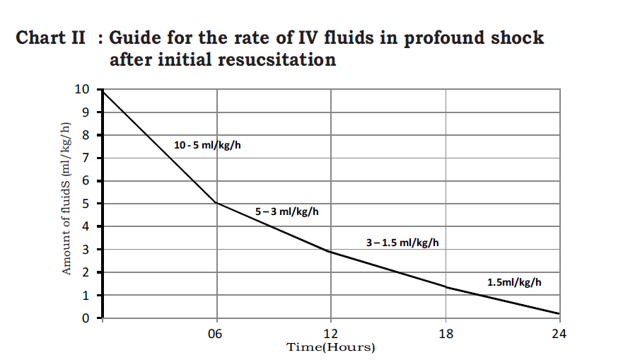
54

Slide 56
Grade C: management of dengue with decompensated shock in adults
Decompensated shock among adults
(hypotension + signs of reduced perfusion) mean arterial pressure (MAP) <65, H high
Start isotonic crystalloid
10–20 mL/kg for 20–30 minutes as bolus
YES
IMPROVEMENT
BP improved, pulse pressure improved, HCT decreased, urine output improved, capillary refilling time improved, pulse rate normal
NO
IV crystalloid, reduce gradually
5–7 mL/kg/h for 1–2 hours
3–5 mL/kg/h for 2–4 hours
2–3 mL/kg/h for 2–4 hours
HCT >45%,
(suspect persistent capillary leakage
HCT <45%
(suspect severe overt bleed), check Hb
(2nd bolus over 15–30 minutes)
Crystalloid or colloid 10-20 mL/kg
3rd bolus if not improved
Blood
transfusion/ packed
RBC
Colloid 10 mL/kg/h for 1 hour
As clinical improvement is noted,
reduce fluid accordingly
No, after 1st bolus
IMPROVEMENT
After 2nd bolus
Stop IV fluids at 24–48 hours
YES
Reduce IV crystalloids 7–10 mL/kg/h for 1–2 hours
Refractory
hypotension, consider inotropes after 3rd bolus
Detail investigation to rule out:
1. cardiogenic shock; 2. septic shock; 3. metabolic cause; 4. organ dysfunction
55
Notes:
2nd and 3rd bolus for how many hours or minutes? Is it same with the 1st bolus which is 20-30 min?
Time duration for bolus infusion is the same for all 1st , 2nd and 3rd bolus.

Slide 57
Grade C: management of dengue with decompensated shock in children
Decompensated shock among children
(hypotension + signs of reduced perfusion) MAP <65, HCT high
Start isotonic crystalloid
10–15 mL/kg for 20–30 minutes as bolus
YES
IMPROVEMENT
BP improved, pulse pressure improved, HCT decreased, urine output improved, capillary refilling time improved, pulse rate normal
NO
IV crystalloid, reduce gradually
5–7 mL/kg/h for 1–2 hours
3–5 mL/kg/h for 2–4 hours
2–3 mL/kg/h for 2–4 hours
HCT > 45%
(suspect persistent capillary leakage
HCT <45%
(suspect severe overt bleed), check Hb
(2nd bolus over 15–30 minutes)
crystalloid or colloid 10–20 or 10-15 mL/kg
3rd bolus if not improved
Blood
transfusion/packed
RBC
Colloid 10 mL/kg/h for 1 hour
As clinical improvement is noted,
reduce fluid accordingly
NO, after 1st bolus
IMPROVEMENT
Stop IV fluids at 24–48 hours
YES
After 2nd bolus
Reduce IV crystalloids 7–10 mL/kg/h for 1–2 hours
Refractory
hypotension, consider inotropes after 3rd bolus
Detailed investigation to rule out: 1. cardiogenic shock; 2. septic shock; 3. metabolic cause; 4. organ dysfunction
56
Notes:
What is the MAP for children, is it same with adult? Which is <65 for both?
To my understanding it is the same MAP <65 is considered for both children and adults
2nd and 3rd bolus for how many hours or minutes? Is it same with the 1st bolus which is 20-30 min?
Time duration for bolus infusion is the same for all 1st , 2nd and 3rd bolus.

Slide 58
Malaria prevention and control
57

Slide 59
Introduction
Malaria is a Protozoal disease, caused by plasmodium & transmitted by infected female anopheles mosquito.
Plasmodium Species-
P. Vivax
P. Falciparum
P. Ovale
P. Malariae
58

Slide 60
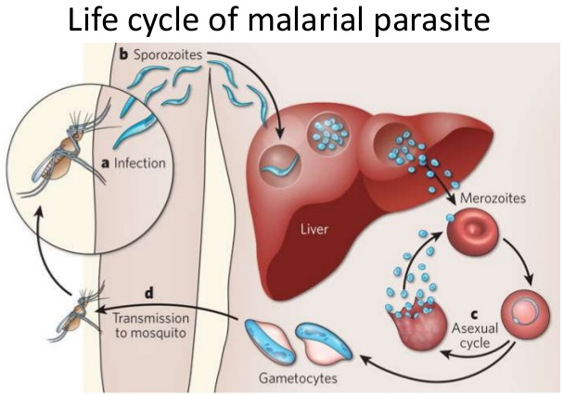
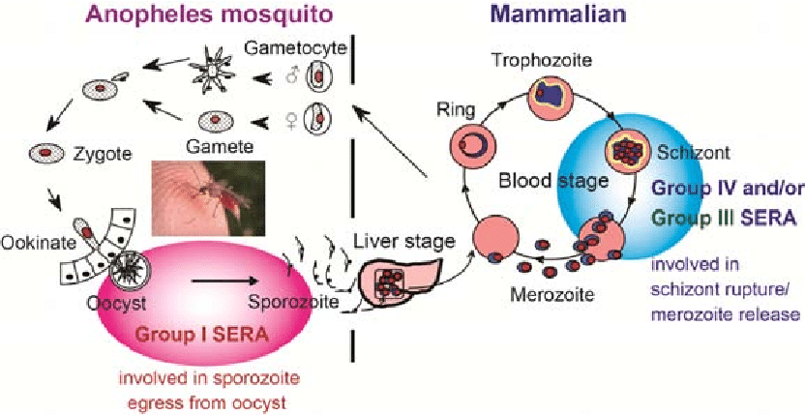
Life Cycle of Malarial Parasite
59

Slide 61
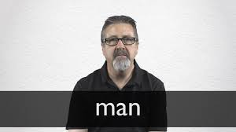
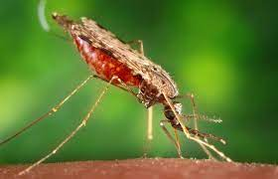
Infective Form
Infective Form to Man- Sporozoites present in salivary gland of female mosquito.
Infective form to mosquito- Gametocytes, to infect mosquito gametocyte must be mature, viable, and in high count.
Infective form to man in case of blood transfusion- merozoites
60

Slide 62
Malaria control
A- Control of vector
(1) Control of Larvae | (2) Control of Adult mosquitoes
Source reduction by reducing breeding places of mosquito | Indoor Residual Spraying in sensitive districts by DDT 50% W.D.P in 2 rounds. First Round- 15 may to 28 July Second Round- 1 August to 14 October In 2018- 11 districts, 2019- 36 districts, 2020- 25 Districts, 2021-22 Districts
Chemical control by using larvicidal spray like Temiphos, B.T.I , Diflubenzuron | Fogging by Malathion (1 : 19 diesel)
Biological control by using larvivores fish Gambusia | Space spray by Pyrethrum 2% (1:19 Kerosene oil)
By making environmental conditions unfavorable for the growth of larvae . For E.g.- ensure proper water drainage. | ---
61

Slide 63
B- Preventive measures to break man-mosquito contact
To encourage use of mosquito nets (if possible, use insecticide treated bed nets) in community.
Educate the people and school children to use full sleeve shirts and trousers.
Use of mosquito repellent cream, mat, mosquito coils etc.
Use of wire screening nets on windows in the houses.
62

Slide 64
C- Management of Malaria cases
Diagnosis | Treatment
Diagnosis of Malaria cases by using bi-valent RDT kits or by microscopic examination of the blood smear. On confirmation, complete treatment to be given. | Aims of national drug policy for effective treatment of Malaria- 1- Providing complete cure of malaria cases. 2- Prevention of progression of uncomplicated malaria into severe malaria and thereby reducing malaria mortality. 3- Prevention of relapses by administration of radical treatment. 4- Interruption of transmission of malaria by using gametocytocidal drug Primaquine. 5- Preventing development of drug resistance by rational treatment of malaria cases.
63

Slide 65
Strengthening of Surveillance
Active Surveillance- Trainings were given to ASHA & ANM for doing malaria testing of fever cases during their visits/camps. Cluster meetings were conducted by our team.
Passive Surveillance- Community awareness & Participation were encouraged with help of IECs, social media, newspaper etc to encourage people to visit near by facility in case of fever.
Further strengthening of coordination with other health partners & local NGOs to re-emphasize on 3Ts (Test, Treat, and Track) and Strengthening Follow-up.
64

Slide 66
Active Case Detection Methodology
ASHA enlists all cases with fever, test for malaria using RDT.
In-case of Pv positive ASHA gives medication and in Pf ASHA sends patient to nearby health facility for medication.
To strengthen the treatment component, ASHA visits patient’s house on 3rd, 7th, and 14th day (Pv) and 2nd and 3rd day (Pf) for follow up.
ASHA visits all households in identified villages during House-to House Surveillance, SRNA/DASTAK
65

Slide 67
Treatment of Malaria
66

Slide 68
What Does Case Management Involve?
PARASITOLOGICAL DIAGNOSIS
APPROPRIATE TREATMENT
PATIENT
FOLLOW-UP
67

Slide 69
Objectives of Case Management
PREVENT ONWARD TRANSMISSION
AVERT COMPLICATIONS
AND DEATH
REDUCE PARASITE RESERVOIR
CURE DISEASE
PREVENT RELAPSE
68
Notes:
[Text for facilitator to say out loud to the class]
In elimination settings, case management takes on some additional objectives on top of those in high-burden countries.
[Click] The primary objectives of case management across all malaria programmes are to cure disease and prevent complications and death.
[Click] In elimination settings, there is additionally the goal of preventing onward transmission from individual cases. This is accomplished by ensuring a complete cure of patients through early identification of suspected cases, correct diagnosis, supervision of appropriate treatment and follow-up of all cases in the appropriate timeframe for the antimalarial medicine and parasite species to ensure cure.
Onward transmission is also reduced through the provision of a single, low dose of primaquine for P. falciparum infections in order to reduce the transmissibility of the infection.
[Click] In elimination settings, good case management can also reduce the size of the parasite reservoir by providing supervised treatment, including radical cure for P. vivax and P. ovale in which a full course of primaquine is given based on the patient’s G6PD deficiency status.
[Click] Providing a full course of primaquine to clear the liver-stage parasites reduces the chance of a future relapse and the chance of onward transmission.

Slide 70
Malaria Parasites in India
Common parasites
P vivax
P falciparum
Rare parasites
P ovale
P malariae ( in tribal forested areas)
P knowlesi No human cases of this species in India. Reported in Malaysia, Singapore
69

Slide 71
Treating uncomplicated malaria
A patient who presents with symptoms of malaria and a positive parasitological test (microscopy or RDT) but with no features of severe malaria is defined as having uncomplicated malaria
The clinical objectives of treating uncomplicated malaria are:-
to cure the infection as rapidly as possible and
The public health objectives of treatment are:-
to prevent onward transmission of the infection to others and
to prevent progression to severe disease.
“Cure” is defined as elimination of al parasites from the body.
to prevent the emergence and spread of resistance to antimalarial drugs.
70

Slide 72
Once a suspected case is diagnosed positive by RDT or microscopy, treatment is started.
The first dose is always taken in the presence of the health volunteer/worker. The blister pack with remaining tablets is given to the patient/caretaker to take home with clear instructions.
Caution: If the patient is a child under 5 years or pregnant, ask the patient to wait for 15 minutes after taking the first dose.
If it is vomited within this period, let the patient rest for 15 minutes, and then give the first dose again i.e. open a new blister-pack and discard what remains of the old.
Explain to the patient/caretaker:
If the patient vomits the first dose again, it is considered a case of severe malaria, refer the patient immediate to the nearest Block PHC/ CHC/ Hospital.
That if the treatment is not completed as prescribed, the disease may manifest again with more serious features and more difficult to treat.
To come back immediately, if there is no improvement after 24 hours, if the situation gets worse or the fever comes back.
71

Slide 73
Uncomplicated malaria caused by P. vivax
Only P. vivax form hypnozoites, which are dormant parasite stages in the liver that cause relapse weeks to years after the primary infection.
P. vivax preferentially invades reticulocytes, and repeated illness causes chronic anaemia, which can be debilitating and sometimes life-threatening, particularly in young children
Although P. vivax has been considered to be a benign form of malaria, it may sometimes cause severe disease. The major complication is anaemia in young children.
The objectives of treatment of vivax malaria are twofold:
to cure the acute blood stage infection and
to clear hypnozoites from the liver to prevent future relapses. This is known as “radical cure”.
72

Slide 74
Uncomplicated malaria caused by P. vivax
In areas with chloroquine-sensitive P. vivax
For chloroquine-sensitive vivax malaria, oral chloroquine at a total dose of 25 mg base/kg bw is effective and well tolerated.
Chloroquine is given at an initial dose of 10 mg base/kg bw, followed by 10 mg/kg bw on the second day and 5 mg/kg bw on the third day.
Preventing relapse in P. vivax
To achieve radical cure (cure and prevention of relapse), relapses originating from liver hypnozoites must be prevented by giving 14-day course of primaquine.
Primaquine is contraindicated in infants, pregnancy and lactation < 6 months post-partum and people with known G6PD deficiency.
73

Slide 75
Uncomplicated P. falciparum malaria
Treat adults and children with uncomplicated P. falciparum malaria (including infants, pregnant women in their second and third trimesters and breastfeeding women) with ACT (Artesunate + sulfadoxine–pyrimethamine).
ACT is a combination of a rapidly acting artemisinin derivative with a longer-acting (more slowly eliminated) partner drug.
The artemisinin component rapidly clears parasites from the blood and is also active against the sexual stages of the gametocytes that mediate onward transmission to mosquitos.
The longer- acting partner drug clears the remaining parasites and provides protection against development of resistance to the artemisinin derivative.
74

Slide 76
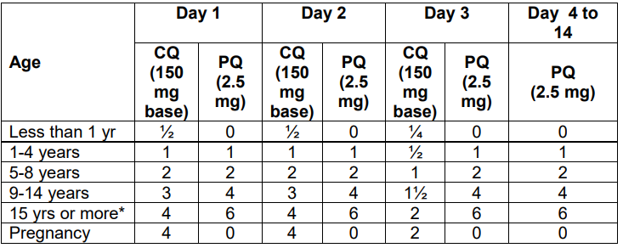
Treatment of Vivax Malaria
Note:
Primaquine should not be given to infants, pregnant women and individuals with G6PD deficiency.
CQ 250 mg tablet is having 150 mg base.
75
Notes:
P. vivax, the second most important species causing human malaria, is the dominant malaria species
Hence,This slide tells about the dosage chart for treatment of Vivax Malaria
The medicine for treatment of Plasmodium vivax are Chloroquine and Primaquine.
1. Chloroquine:
The tablets are given on different days as per age group.
For example:
For infants below 1 year of age, the dosage of only chloroquine includes-
Chloroquine ½ tablet per day is given for 2 days and ¼ tablet is given on 3rd day.
For children between 1 to 5 years of age, the dosage of chloroquine and primaquine includes-
Chloroquine: 1 tablet is given for 2 days together with Primaquine 2.5 mg. On 3rd day, ½ tablet of chloroquine and 1 tablet of primaquine is provided.
For treatment of children between 5-9 years of age, the dosage of chloroquine and primaquine includes-
2 tablets Chloroquine 250 mg and 2 tablets of primaquine 2.5 mg for 1st two days and then 1 tablet of chloroquine and 2 tablets of primaquine on 3rd day. The primaquine 2 tablets are given for a total of 14 days for complete treatment
For treatment of children between 9 and 15 years, the dosage of chloroquine and primaquine includes-
3 tablets of Chloroquine 250 mg and 4 tablets of primaquine 2.5 mg is given for 1st 2 days followed by 2 tablets of chloroquine and 4 tablets of primaquine on Day 3. Primaquine is continued for14 days for complete treatment
For all patients above 15 years, the dosage of chloroquine and primaquine includes-
4 tablets of Chloroquine 250 mg and 6 tablets of primaquine 2.5 mg is given for 2 days, followed by 2 tablets of chloroquine and 6 tablets of primaquine on Day 3.
Primaquine is then continued for a total of 14 days for complete treatment
2. Primaquine: 0.25 mg/kg body weight daily for 14 days should be given under supervision.

Slide 77
Treatment of Falciparum Malaria
Region | Drug Regimen/ Dosage
North-Eastern States | ACT-AL Co-formulated tablet of Artemether(20 mg) - Lumefantrine (120 mg)* Tab. Primaquine: 0.75 mg/kg body weight on day 2
Other than North-Eastern States | Tab. Artesunate (AS)- 50 mg for 3 days Tab. Sulfadoxine Pyrimethamine (SP) (500mg+25 mg) – for 1 day Tab. Primaquine (PQ) 0.75 mg/kg body weight on day 2
Primaquine is not recommended for pregnant women, infants and individuals with G6PD deficiency.
*Not recommended during the first trimester of pregnancy and for children weighing < 5 kg
76
Notes:
Now we will learn about the treatment of uncomplicated malaria.
This slide explains about treatment of Falciparum Malaria.
For Plasmodium falciparum malaria the treatment is different for the Northeast states like Assam, Mizoram, Manipur, Nagaland, Meghalaya, Tripura and Sikkim and it is different for other states.
The treatment for all other states is Artemisinin based Combination Therapy (ACT-SP) This includes Tablet Artusunate 25 mg) and tablet Sulfadoxin Pyremethamine (SP)
For the Northeast states, it is ACT-AL. This includes Tablet Artesunate ( 25 mg) and Tablet Lumifantrine 120 mg)
In all states additionally, Primaquine tablets should be given on the second day only for 1 day.
All tablets for a day should be taken together, swallowed with water.
ACT is not to be given in 1st trimester of pregnancy.
SP is not to be prescribed for children <5 months of age and should be treated with alternate ACT

Slide 78
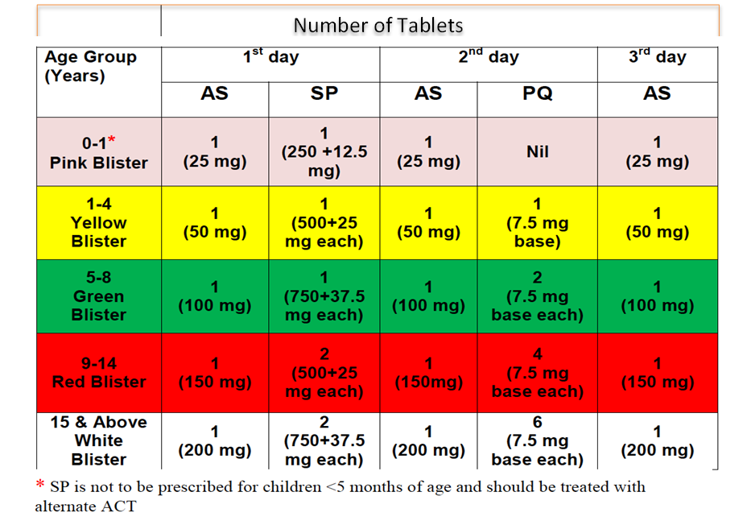
Treatment of P. falciparum with ACT-SP (Except NE States)
Age wise colour codes of packs
Primaquine and ACT-SP are not to be given to pregnant women. They should be treated with alternate ACT.​
77
Notes:
This slide describes The treatment chart for all states other than the Northeast states.
It is Artemisinin based Combination Therapy (ACT-SP) This includes Tablet Artusunate 25 mg) and tablet Sulfadoxin Pyremethamine (SP)
The dosage schedule is available as per colour coded blister packs.
The pink blister pack is for children below 1 year of age.
The yellow colour pack is for children between 1 to 4 years, the green is for 5 to 8 years, red for 9 to 14 years and white is for all above 15 years of age.
The medicines are given for 3 days as detailed in the chart given in the slide.
Primaquine and ACT-SP are not to be given to pregnant women. They should be treated with alternate ACT.

Slide 79
Treatment of P. falciparum in Pregnancy
Treatment Regimen
First Trimester: Quinine 10mg/kg/TDS X 7 days Second and Third Trimester: NE States: ACT-AL combination Other States: ACT-SP combination
Malaria in pregnancy, is a serious condition. It can lead to severe anemia, high risk of abortion in early pregnancy, increased chances of stillbirth and low birth weight.
Note: Pregnant women with malaria should be referred to the nearest PHC or hospital immediately, without delay.
78
Notes:
This slide describes the treatment regimen for uncomplicated malaria during pregnancy.
In the 1st Trimester of pregnancy Quinine salt 10mg/kg 3 times daily is given for 7 days.
It should be noted that Quinine may induce hypoglycemia(low blood sugar level). Therefore, pregnant women should not start taking quinine on an empty stomach and should eat regularly, while on quinine treatment
While in the 2nd and 3rd trimester: Area-specific ACT as per dosage schedule is shown in the slide. ACT-AL is given in North-Eastern states while ACT-SP in other states
Please note that, PQ tablets should be taken after a meal and not on an empty stomach.

Slide 80
Treatment of Mixed Infection
Treatment of mixed infections of P. falciparum with P. vivax
ACT is recommended for mixed infections of P. falciparum and other species.
In North-Eastern States: AL for 3 days + Primaquine 0.25 mg per kg body weight daily for 14 days.
In Other States: AS +SP 3 days + Primaquine 0.25 mg per kg body wt. daily for 14 days.
79
Notes:
This slide explains ,Treatment of Vivax Malaria
Primaquine is contraindicated in infants, pregnant women and individuals with G6PD deficiency.14-day regimen of Primaquine should be given under supervision. Patients should be instructed to report back in case of rash, haematuria or high coloured urine / cyanosis or blue coloration of lips and Primaquine should be stopped in such cases. Care should be taken in patients with anaemia.
Next we learn about Treatment of mixed infections of P. falciparum with other species.
ACT is recommended for mixed infections of P. falciparum and other species. A 14-day course of primaquine should be given for mixed infections including P. vivax and/or P. ovale
In North-Eastern States: AL for 3 days + Primaquine 0.25 mg per kg body weight daily for 14 days.
In Other States: AS +SP 3 days + Primaquine 0.25 mg per kg body wt. daily for 14days.

Slide 81
Severe Malaria
One or more of the following clinical features or laboratory findings, in the absence of an identified alternative cause and in the presence of asexual malaria parasitemia.
Clinical Features
Impaired consciousness
Prostration
Multiple convulsions
Acidotic breathing
Acute respiratory distress
Shock
Acute kidney injury
Jaundice with vital organ dysfunction
Significant bleeding
Laboratory findings
Hypoglycemia
Severe anaemia
Metabolic acidosis
Haemoglobinuria
Hyperlactataemia
Renal impairment
Pulmonary oedema
Hyperparasitaemia
80
Notes:
[Text for facilitator to say out loud]
Severe malaria can be dangerous to a patient and must be identified and treated immediately to prevent death.
For all malaria parasites, severe malaria is defined as presence of asexual parasitemia for malaria and at least one or more of the signs or symptoms of severe disease listed in this table.
The clinical features of severe malaria include impaired consciousness or coma, prostration, convulsions, acidotic breathing, acute respiratory distress, shock, acute kidney injury, jaundice with vital organ dysfunction or significant bleeding.
The laboratory findings can include hypoglycaemia, severe anaemia, metabolic acidosis, haemoglobinuria, hyperlactataemia, renal impairment or pulmonary oedema.
Hyperparasitaemia, or a high parasite density, in infections with P. falciparum and P. knowlesi is also a reason to classify a patient as having severe malaria.

Slide 82
Treatment of Severe Malaria
1
If complete treatment of severe malaria is not possible, provide pre-referral treatment as appropriate and refer to an appropriate facility for further care.
2
Treat all patients with intravenous or intramuscular artesunate for at least 24 h and until they can tolerate oral medication.
3
Complete treatment orally with 3 days of an artemisinin-based combination therapy.
81
Notes:
[Text for facilitator to say out loud]
Death from severe malaria often occurs within hours of admission to a hospital or clinic, so it is essential that therapeutic concentrations of a highly effective antimalarial drug be achieved as soon as possible. Management of severe malaria comprises mainly clinical assessment of the patient, specific antimalarial treatment, additional treatment and supportive care.
Patients with suspected severe disease should be referred as quickly as possible to the nearest referral hospital (sometimes known as a “tertiary care” facility) to ensure appropriate care, regardless of age or point of contact. It is currently not recommended to wait for a confirmatory diagnosis.
[Click] Where complete treatment of severe malaria is not possible but injections are available, adults and children should be given a single, intramuscular dose of artesunate and referred to an appropriate facility for further care.
Where intramuscular artesunate is not available, intramuscular artemether or, if that is not available, intramuscular quinine should be used.
When intramuscular injection of artesunate is not available, children under 6 years old can be treated with a single rectal dose of artesunate in suppository form. Children who receive rectal artesunate must be referred immediately to an appropriate facility for further care.
[Click] Adults and children with severe malaria (including infants, pregnant women in all trimesters and lactating women) should be treated with intravenous or intramuscular artesunate for at least 24 hours and until they can tolerate oral medication.
[Click] Once a patient has received at least 24 hours of parenteral therapy and can tolerate oral therapy, the patient’s treatment should be completed with three days of an ACT and a single, low dose of primaquine if the infection is due to P. falciparum.
Follow-up post-discharge of patients who have been treated for severe malaria is critical to ensure complete cure and to assess for any potential relapse or recrudescence of the malaria parasite.

Slide 83
Treatment of Severe Malaria
Artesunate: 2.4 mg/kg i.v. or i.m. given on admission (time=0), then at 12 h and 24 h, then once a day.
Pregnant women with severe malaria in any trimester can be treated with artemisinin derivatives, which, in contrast to quinine, do not risk aggravating hypoglycaemia.
Quinine: 20mg quinine salt/kg body weight on admission (IV infusion or divided IM injection) followed by maintenance dose of 10 mg/kg 8 hourly; usually diluted in 5% dextrose and infused over 4 h, infusion rate should not exceed 5 mg/kg per hour.
Once the patient can take oral therapy, give: Quinine 10 mg/kg three times a day in pregnant women to complete 7 days of treatment, in patients started on parenteral quinine.
The parenteral treatment should be given for minimum of 48 hours
After parenteral artesunate therapy, patients will receive a full course of Area-specific oral ACT for 3 days.
Note:
82

Slide 84
Treatment Supervision and Patient Follow-Up
Follow-up contributes to patient safety and interruption of transmission
Treatment supervision and follow-up can be conducted at a health facility/ ASHA
The follow-up period depends on the parasite species and type of antimalarial used
Microscopy must be used to document parasite clearance
83
Notes:
[Text for facilitator to say out loud]
In settings approaching elimination, supervising the treatment of patients and following them can improve compliance, cure and contribute to interruption of transmission.
Patient follow-up can be organized by scheduling patients to return to the health facility at a future date or by using community health workers to visit patients in their home.
[Click] Patient follow-up contributes to patient safety by helping to identify any patient who has had a recrudescence or relapse and providing them with appropriate treatment. Patient follow-up also helps to interrupt transmission by ensuring complete cure.
[Click] We follow up patients at designated time points depending on the parasite species and antimalarial drug given.
For all species, the first follow-up should be, at minimum, at day 28 or day 42 after treatment. We use day 28 when the antimalarial has a shorter half-life, for example, artemether-lumefantrine (AL) or artesunate-SP. We use day 42 when the antimalarial has a longer half-life, for example, dihydroartemisinin-piperaquine or artesunate-mefloquine.
Additionally, for P. vivax and P. ovale, WHO recommends a follow-up again at three months to check for relapses. In some settings, P. vivax patients should be followed up for one year.
[Click] At minimum, all infected individuals should receive a clinical consultation and parasitological evaluation on the last day of follow-up. Because of the long persistence of the antigens used in the RDTs, microscopy must be used for the parasitological evaluation.
Patient follow-up should be documented in their health records and in the national malaria database.
Patient follow-up should take place for all patients as part of good case management. In a few minutes, we will also talk about how information on patient follow-up can be used as part of a strategy to monitor the effectiveness of antimalarial medicines.

Slide 85
Criteria for Referral
Criteria: Patients should be referred to tertiary care facility if they have any one or more of the complications of severe malaria like convulsions,Pulmonary oedema, bleeding and clotting disorder.
Referral from: Centers/clinics who do not have indoor facility
In case the patient does not get relief from symptoms of malaria within 48 to 72 hours
Referral from: Small nursing homes/hospitals
The Medical Officer should liaise with all nearby referral facilities
The MO should decide for timely transportation of these cases if required
Adequate immediate care to all patients of severe malaria before higher referral.
Blood smear examination and parasite count should also be made before referral.
84
Notes:
At centres/clinics who do not have indoor facility In case the patient does not get relief from symptoms of malaria within 48 to 72 hours, and/or develop symptoms or signs of severe malaria patient should be referred. The danger signs are
• Continuous vomiting and inability to retain oral drugs • Severe dehydration,
• Feeling too weak to walk
• Change in sensorium e.g., confusion, drowsiness, blurring of vision, photophobia, disorientation
• Convulsions
• Bleeding and clotting disorders
• Suspicion of severe anaemia
• Jaundice • Hypothermia
• Severe Anaemia
• Jaundice At level of small nursing homes/hospitals
• The medical officer should liaise with all nearby referral facilities
• The MO should make arrangements for timely transportation of these cases if required
• Adequate immediate care to all patients of severe malaria before higher referral for which the following facilities should be available
• Blood smear examination and parasite count.
• RDT
• Routine exam of urine and haemoglobin estimation.
• Oral antimalarial drugs including ACT
• Injectable Quinine, injectable artemisinin preparation
• Saline / glucose / dextrose for intravenous transfusion.
• Oxygen for serious and complicated cases. 33
• Antipyretics, anticonvulsants, diuretics, antibiotics. Criteria for referral from PHC to referral / district hospital Patients should be referred to tertiary care facility if they have any one or more of the complications of severe malaria,
• Cerebral malaria patients not responding to initial treatment with intravenous Quinine.
• Severe anaemia warranting blood transfusion.
• Bleeding and clotting disorder.
• Hemoglobinuria.
• Pulmonary oedema
. • Cerebral malaria complicating pregnancy.
• Oliguria not responding after correction of fluid deficit and administration of diuretics. Fluid electrolyte and acid base disturbance. Patients with severe malaria who do not respond to antimalarials or those who worsen despite treatment should be referred. Referral should be more prompt in cases of pregnant women, postpartum women and children below five years with severe malaria, because they have a higher risk of complications.
The following facilities should be available at the referral centre to which severe malaria cases are referred:
• Specialized biochemical, radiological, and microbiological tests
• Intensive care management and round-the-clock monitoring to deal with the critical illness
• Ventilatory support, particularly volume ventilator
• Blood transfusion
• Peritoneal dialysis

Slide 86
Public support in Disease mitigation
85

Slide 87
Be Aware and Educated
Public awareness about the causes, symptoms, prevention, and treatment of various diseases is essential fpr disease mitigation and control.
Government agencies, NGOs, healthcare organizations, and community groups conduct awareness programs through various media channels, including television, radio, newspapers, posters, and social media platforms.
House to House Dastak Campaign is a state wide Awareness generation and Behaviour change campaign conducted by the state in the Months of April, July and October every year.
Public should co-operate with the Front line workers visiting their houses for awareness generation and follow simple measures for disease prevention as told by these workers.
86

Slide 88
Community Engagement
Community participation is vital in implementing disease control measures at the grassroots level.
Environmental Management: Maintain clean surroundings, Ensure proper waste disposal, and sanitation practices
Local communities should collaborate with authorities to
Identify breeding sites of mosquitoes
Participate in clean-up drives to eliminate stagnant water
Promote hygiene practices to prevent the spread of diseases.
87

Slide 89
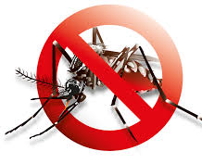
Use of Preventive Measures to break man-mosquito contact
Mosquito nets (if possible, use insecticide treated bed nets) in community.
Full sleeve shirts and full length trousers.
Use of mosquito repellent cream, mat, mosquito coils etc.
Use of wire screening nets on windows in the houses.
88

Slide 90
Seeking Healthcare
Remember the Slogan :
“बुखार में देरी, पढ़ेगी भारी”
Timely detection and treatment of diseases are crucial in preventing their spread.
Seeking healthcare services FROM A QUALIFIED PRACTIONER OR PUBLIC HEALTH FACILITY promptly when experiencing symptoms of diseases helps in early diagnosis and effective management, thereby reducing morbidity and mortality.
89

Slide 91
Compliance with Health Regulations
Adherence to health regulations and guidelines issued by authorities during disease outbreaks, such as
Quarantine measures
Social distancing
Wearing masks,
Vaccination drives
Supporting vector control measures
helps in containing the spread of infectious diseases.
90

Slide 92
Home based care of common communicable disease conditions
91

Slide 93
Rest and Comfort
Isolation
Encourage the individual to get plenty of rest to support their immune system and aid in recovery.
Provide comfortable bedding and a quiet environment conducive to restful sleep.
it's important to isolate a person diagnosed with any communicable disease from other household members to prevent transmission.
Provide them with a separate room and bathroom if possible.
Limit contact with others, especially those who are at higher risk of complications, like elderly individuals or individuals with weakened immune systems.
Use mosquito nets for all family members if the disease is mosquito borne.
92

Slide 94
Hygiene Practices (For droplet infections)
Emphasize proper hand hygiene for all household members.
1
Encourage frequent handwashing with soap and water for at least 20 seconds, especially after coughing, sneezing, or using the bathroom.
2
Provide alcohol-based hand sanitizers for times when soap and water are not readily available.
3
93

Slide 95
Symptomatic Treatment
Fever and pain management
Paracetamol (15mg/kg body weight) can be given to reduce fever and relieve pain.
Cold sponging for Fever of more than 101⁰c
Ensure Hydration
Very important in Viral illnesses like Dengue and Chikungunya and Diarrhoeal diseases.
Provide plenty of fluids, such as water, soup, juices or ORS (electrolyte solutions).
Nutrition
Maintains adequate nutrition by providing a balanced diet rich in fruits, vegetables, lean proteins, and whole grains.
Offer easy-to-digest foods if the individual has gastrointestinal symptoms.
Consult your nearest Public health care facility or a qualified practitioner
As early as possible
Immediately if you observe any danger signs in the patient
94

Slide 96
Monitor Symptoms
Keep a close eye on the individual's symptoms
Monitor for any worsening or new symptoms.
Contact a healthcare provider immediately if there are any warning/danger signs
1. Persistent fever despite antipyretic medication
2. Persistent headache
3. Drowsiness, low BP
4. Inability to take food orally
5. Convulsions
6. Change in mental status, Verbalization, Unconsciousness
95

Slide 97
Role of Private sector in disease prevention, outbreak alert generation and response
96

Slide 98
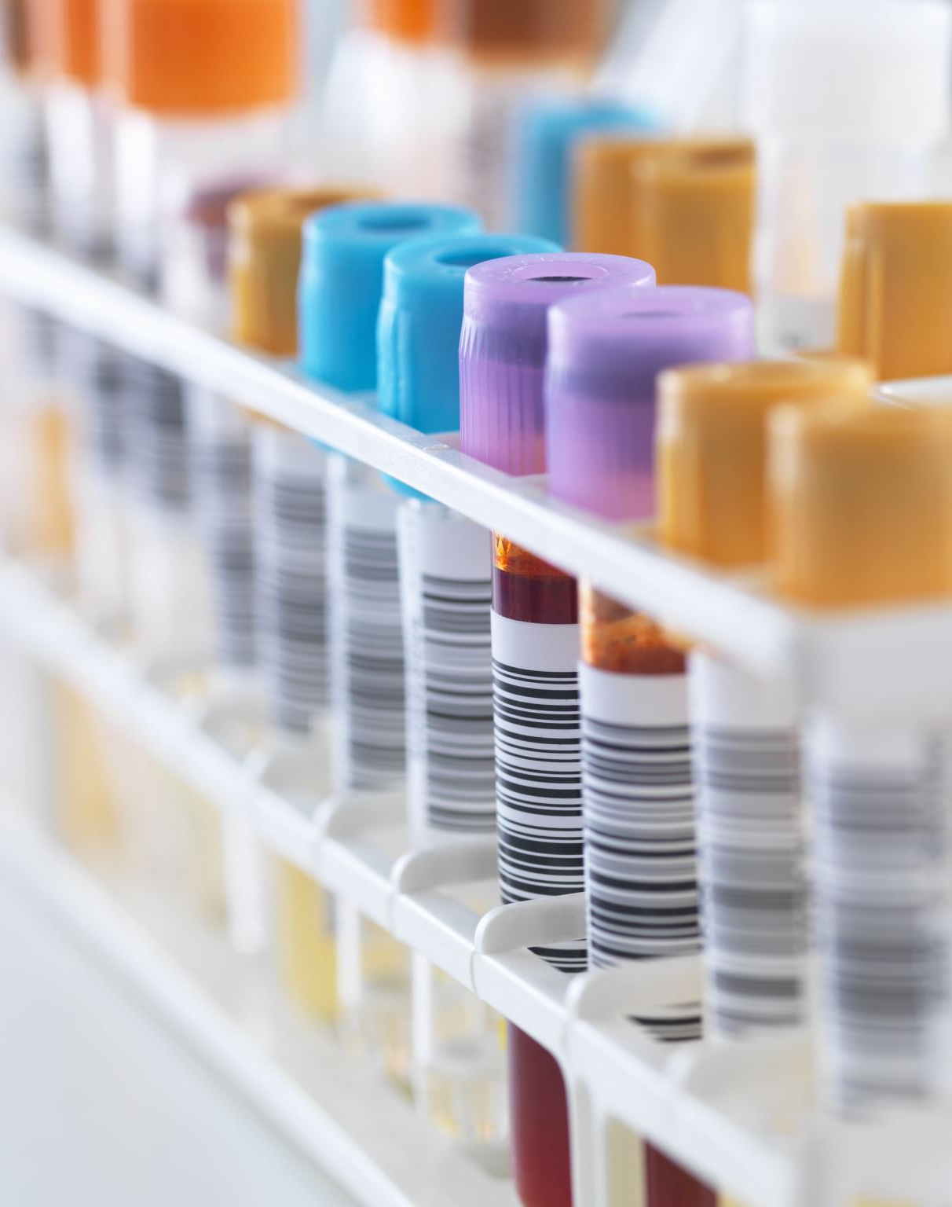
Healthcare Services and Facilities
Private hospitals, clinics, diagnostic laboratories, and healthcare providers contribute to disease prevention by offering medical services, screenings, vaccinations, and treatments.
Due to the sheer numbers being catered to by the private sector health facilities, they play a crucial role in early detection and management of communicable diseases, as well as providing healthcare infrastructure during outbreaks.
97

Slide 99
Surveillance and Data Collection
More than 70% of patients are treated at Private sector health facilities.
Therefore, Private sector is pivotal to health care delivery mechanism in our country and state.
Private healthcare facilities and laboratories collect a very large dataset on various disease conditions.
Simple reports like individual OPD records and Lab reports when made available from individual private facilities to District surveillance unit, create a huge data pool which can be used to
Assess disease trends
Monitor rising trends
Prevent and manage outbreaks.
98

Slide 100
Unified Disease Surveillance Portal
www.udsp.in
99

Slide 101
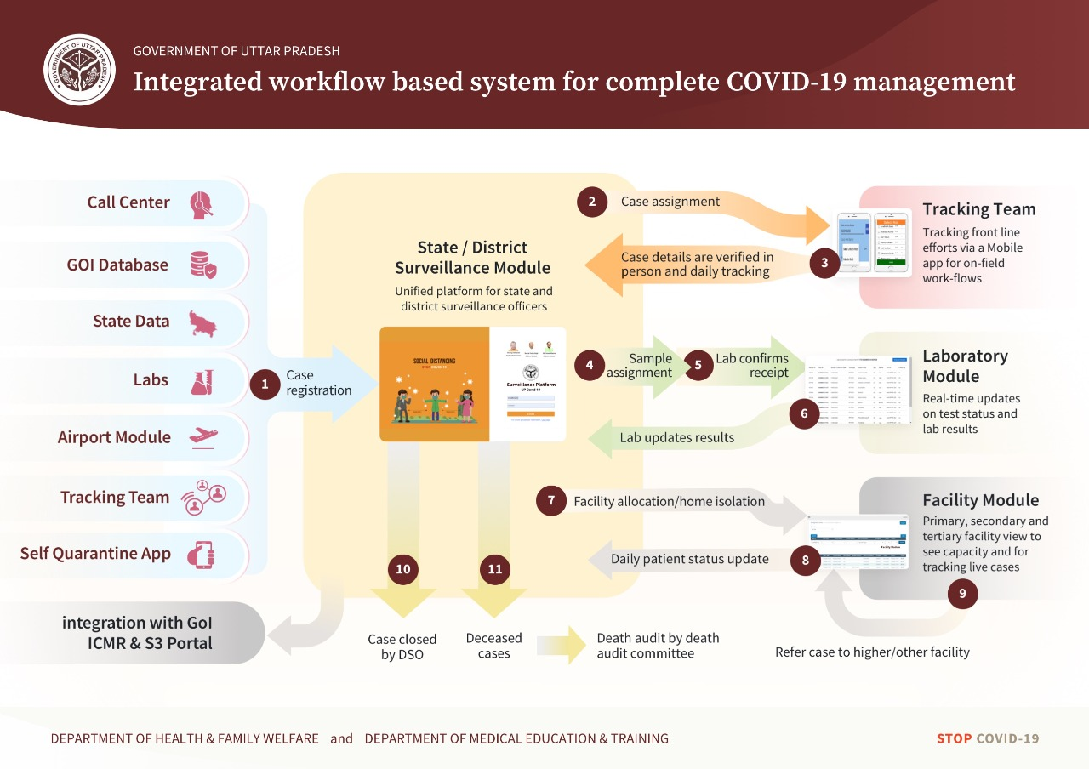
COVID Portal – Lessons Learned
Learnings
Surveillance needs keep changing, necessitating a flexible system
Symptoms – Questions
Lab Tests – Type, Parameters, Samples
Facilities – Labs & Hospitals
Geography under surveillance
Human Resources conducting the surveillance
Learnings
Surveillance needs keep changing, necessitating a flexible system
Diseases – Communicable/ NCD/Registries
Geography focus
Community - Facility–Lab linked surveillance
Changing protocols from time to time
Symptoms – Questions
Lab Tests – Type, Parameters, Samples
Automatic alerts are required
Single source of truth – Integrated with all national+state platforms
Integration with GoI ICMR & S3 Portal
100

Slide 102
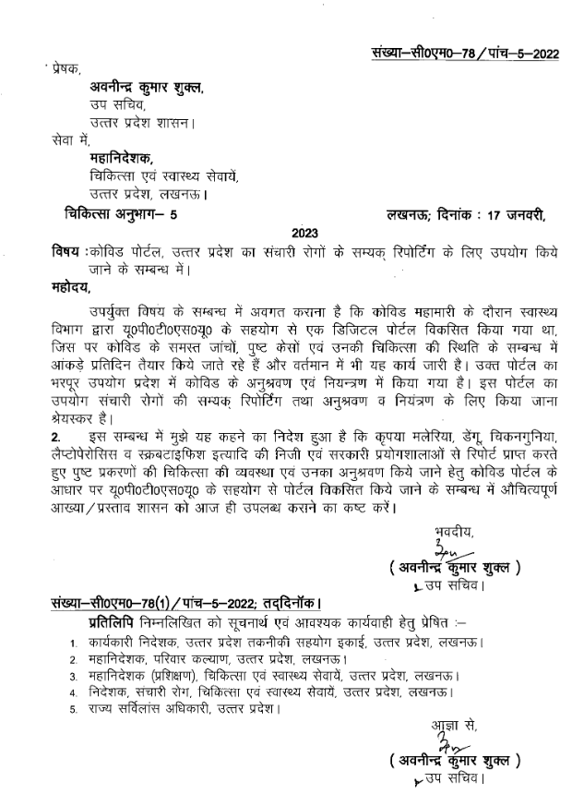
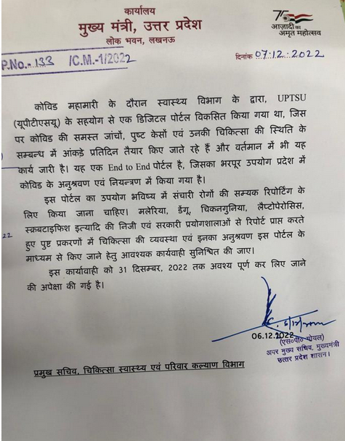
Chief Minister Office, Uttar Pradesh
Letter No. 133/C.M.-1/2022 dated 07 Dec 2022
Letter No. C.M.-78/Five-5-2022 dated 17 Jan 2023
101

Slide 103
Communicable Notifiable Diseases
Disease
Tests
Symptoms
Questions
Rapid Diagnostic Kit (RDT)
BS/PBS/Slide test
QBC
Fever less than 7 days
Altered Sensorium
Chills
1. Do you have Fever?
2. If yes, How many days?
1
Malaria
IgM ELISA
PCR (Qualitative)
IgG Elisa
NS1 Elisa
NS1 RDT/Antigen Serotyping
Bleeding, Rash
Fever less than 7 days Altered Sensorium
2
Dengue
IgM ELISA
PCR (Qualitative)
NS1 Elisa
Fever less than 7 days
Joint pain
Altered Sensorium
3
Chikungunya
Japanese Encephalitis
IgM ELISA
PCR (Qualitative)
Fever less than 7 days
Altered Sensorium
4
5
Scrub typhus
IgM ELISA
PCR (Qualitative)
Weil felix
Fever less than 7 days Rash
102

Slide 104
Communicable Notifiable Diseases
Disease
Tests
Symptoms
Questions
6
Leptospirosis
IgM ELISA
PCR (Qualitative)
MAT
Jaundice
Fever less than 7 days
1. Do you have Fever?
2. If yes, How many days?
Kala Azar
Rapid Diagnostic Kit (RDT)
IFAT
Fever > 2 weeks
7
TRUENAT
RDT (HBsAg)
HBeAb
HBcIgM Elisa
PCR (Quantitative)
Hepatitis B
Fever with jaundice
8
TRUENAT
Rapid Diagnostic Kit (RDT)
Anti-HCV IgM Elisa
PCR (Quantitative)
Hepatitis C
Fever with jaundice
9
103

Slide 105
Communicable Notifiable Diseases
Disease
Tests
Symptoms
Questions
Typhoid
Widal
RDT (Typhidot) for Salmonella
Fever more than 7 days
1. Do you have Fever?
2. If yes, How many days?
10
11
Cholera
Culture
Rapid Cholera (VC) Dipstick Test
Acute watery diarrhoea
Filaria
PCR (Qualitative)
Slideexamination/Microscopy
FTS
Swelling in any dependent part of body?
12
104

Slide 106
UDSP URLs
LIVE URLs
Training URLs
Lab Platform: https://labs-preprod.updsp.in/
Lab Platform: https://labs.udsp.in
Facility Platform: https://facility.udsp.in
Facility Platform: https://facility-preprod.updsp.in/
Citizen Lab Report: https://labreports.udsp.in
Citizen Lab Report: https://labreports-preprod.updsp.in/
Note: LIVE URLs will be active on 14th May 2023. Please do not use them till further instructions by SSO office
105

Slide 107
Benefits of using UDSP
No paper based/Email reporting for these 12 Notifiable Diseases.
Ease to Citizens for accessing their individual online availability of QR based lab report/s.
Better Outbreak alert and response mechanism in the state : Faster Response in Health care services.
Access to Patients longitudinal Health Records.
Improved Quality of Health Care Delivery.
Incentive based on EHR generation by Health Facilities & Labs.
106

Slide 108
DHIS Incentive Structure
Lab & Imaging Centers
Rs. 20 per additional transaction above 100
Digital Solution Companies
Health Locker & Teleconsultation
Rs. 5 per additional transaction above 100
Health Facilities
Rs. 20 per additional transaction above 100
Additional incentive of 20% available for certain DSC’s who have NABH/QCI
Digital Solution Companies
HMIS & LMIS
Rs. 5 per additional transaction above 100
Additional incentive of 20% available for certain DSC’s who have NABH/QCI
107

Slide 109
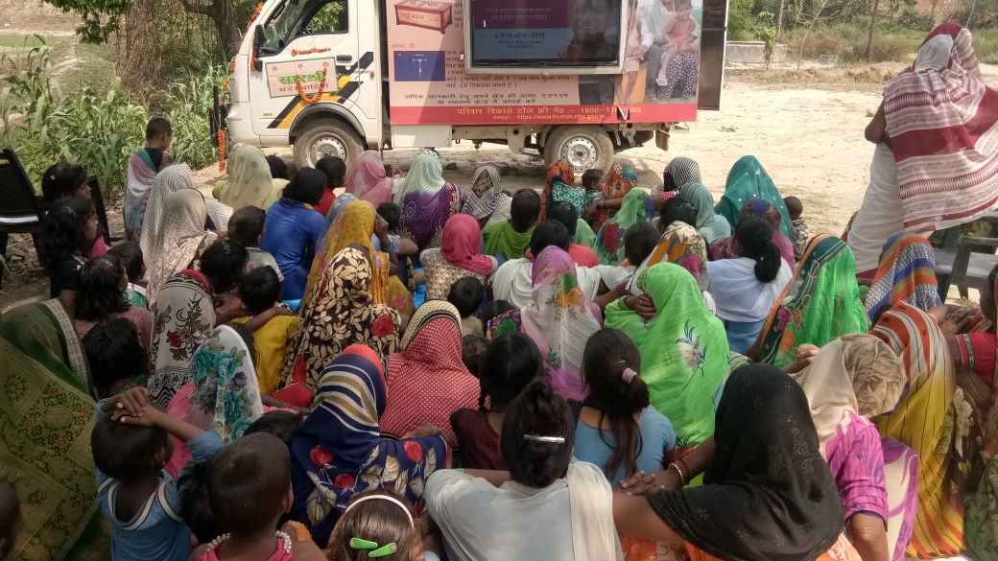
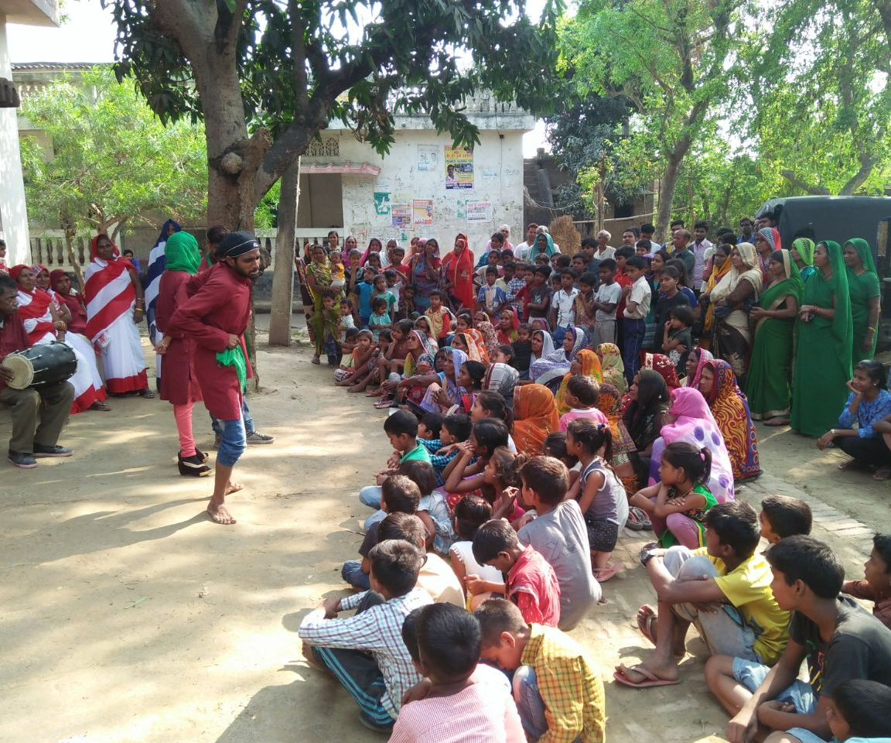
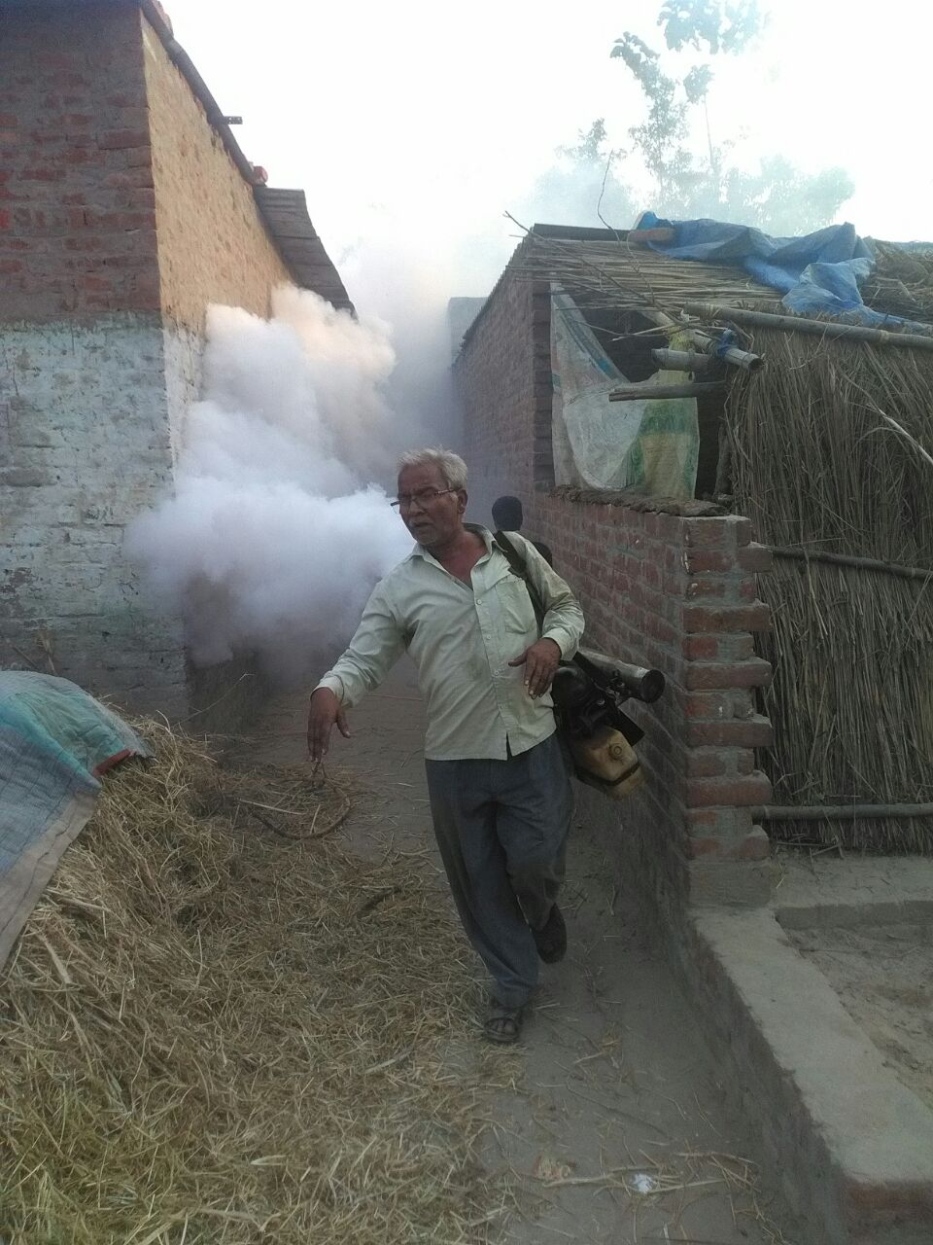
संचारी रोग नियंत्रण एवं
दस्तक अभियान
108

Slide 110
Sanchari Rog Niyantran Aabhiyan
Prevention of diseases, identifying rising trends of diseases and managing them before they turn into outbreaks is more important than treatment of individual cases.
Treatment of disease conditions and timely referral of patients is something that can be done by Health department only.
But, Disease prevention and mitigation requires multidimensional efforts involving various Government departments and stake holders from various NGOs.
Therefore, the state of UP has adopted a Whole of the Government approach for disease prevention and mitigation.
12 Different government departments have well defined roles and responsibilities for disease mitigation and execute different preventive measures based on their micro plans of activities.
Thrice every year (in the months of April, July, October) all departments conduct co-ordinated activities in the form of “Sanchari Rog Niyantran Aabhiyan.”
Simultaneously, trained Front Line workers (ASHAs and AWWs) conduct a house to house sensitization and Behaviour change campaign (BCC) called “Dastak”.
109

Slide 111
Activities in SRNA
Focus on Prevention.
Micro plan based predefined activities by different government departments.
110

Slide 112
Preventive activities : Vector control
Mosquitoes
Identifying high vector density areas
Previous year data
Data from DBCs and Dastak
Mosquito control activities
Breeding site identification
Prevention of mosquito breeding
Activities for control of Adult mosquitoes (Fogging)
Anti Larva measures (Antilarval spray)
Avoiding mosquito bite
Use of mosquito nets
Mosquito repellent cream
Full sleeved shirts and full length pants for students
111

Slide 113
Preventive activities : Vector Control
Rodents (Department of Agriculture)
Important because cases of Scrub Typhus and Leptospirosis are being regularly reported from various districts of the state
Sensitization on rodents as carriers of different diseases
Sensitization on rodent control measures
Distribution of Anti rodent chemicals
112

Slide 114
Animal Husbandry department
Important because
Cases of different zoonotic diseases like Leptospirosis are being regularly reported from various districts of the state
Animals are secondary/reservoir hosts in many human diseases
Unclean and unhygienic conditions in Animal sheds can contribute to spread of diseases in Animals and Humans
Activities
Sensitization of Animal farmers
Monitoring of animal farms for general cleanliness
Motivating for shifting animal farms away from inhabited areas
113

Slide 115
Urban development / Rural Development and Panchayati Raj departments
These departments paly the most crucial role for disease prevention in Urban and Rural populations respectively
IEC activities
Mosquito and rodent control measures (Survey, notices to defaulters, Adulticide and larvicidal activites) and sensitization for the same
Identification and marking of unsafe water sources, ensuring supply of potable water
Environmental cleanliness
114

Slide 116
Integrated Child Development Scheme (ICDS)
Ensuring training of AWWs on various public health and disease mitigation aspects
Identification of children with malnourishment
Referral of SAM (Severe acute malnutrition) children to NRCs (Nutritional rehabilitation centres)
115

Slide 117
EDUCATION DEPARTMENT
Sensitization of students and guardians about
Various activities like Poster making, Quizzes etc for promoting health education
Health education through Prayer meetings, special classes etc.
Environmental cleanliness
Personal hygiene
Symptoms of common diseases
Prevention of Heat related illnesses
116

Slide 118
THANK YOU
DR VIKASENDU AGARWAL State Surveillance Officer, UP
M: 9219793100 / 9286783100 Mail vikas_agg22@yahoo.co.in
idspup@gmail.com
117

